Slide 1
HOW TO CONDUCT AN EVALUATION
Jerome De Lisle

Slide 2
2012 Specialization Courses
Introduction to the Evaluation of Educational & Social Systems (4 Credits)
Definitions & History (1)
Profession & Competencies (1)
Issues & Standards (2)
Targets-Systems, Programmes, Curricula (3)
Benefits, Challenges, & Practice (2)
Evaluation in Schools (2)
Evaluation in Communities (2)
Evaluating National Systems
National Assessment (5)
Cross-Country & International Assessments (5)
Project (3)
Evaluation Designs (4 Credits)
Evaluation Models (4)
Evaluation Designs (6)
Protocol
Qual, Quan, MM
The Practice of Evaluation Designs (3)
Evaluation Project (9 Credits)
Develop an evaluation workplan (8)
Implement workplan (12)
Write & present report (6)

Slide 3
Reading
Free material http://teacherpathfinder.org/School/Assess/assess.html
http://www.tbs-sct.gc.ca/eval/pubs/func-fonc/func-fonc_e.asp#s5
http://www.managementhelp.org/evaluatn/fnl_eval.htm
http://www.ehr.nsf.gov/EHR/REC/pubs/NSF97-153/START.HTM#TOC
http://www.utas.edu.au/pet/sections/developing.html
http://www.chrc-caribbean.org/Downloads/files/Evaluation%20workplan.pdf#search=%22developing%20an%20evaluation%20design%22

Slide 4
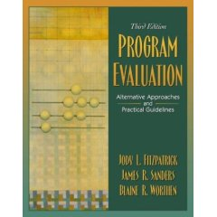


Reading
Base Texts

Slide 5
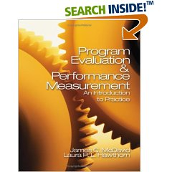

Reading - references

Slide 6
Evaluate what?
Education system/quality
Schools/Institutions
Programs/Projects/Processes/Products
People

Slide 7
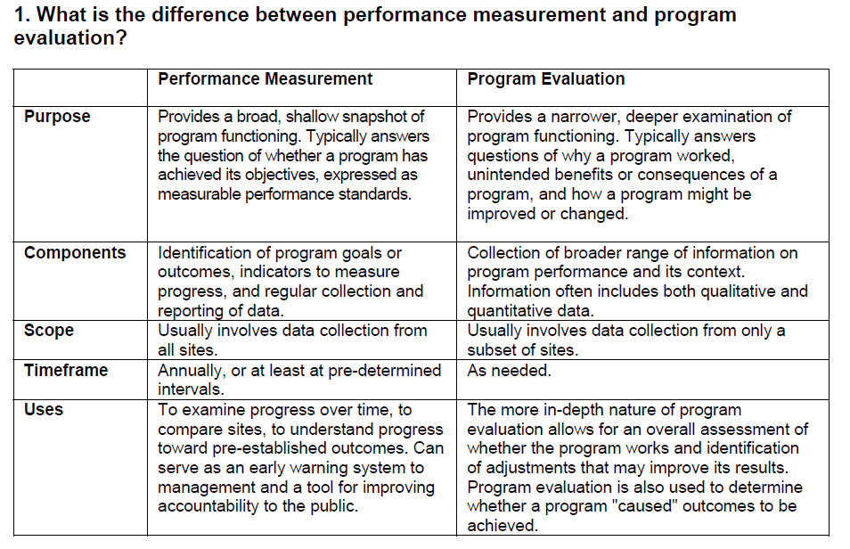

Slide 8
Performance Management of Programmes
Performance Measurement is an ongoing monitoring and reporting of program accomplishments, against progress towards pre-established goals. Both Program Evaluation and Performance Measurement can help identify areas of programs that need improvement, and whether the program or project is achieving its goals and objectives and the reason why.

Slide 9
Evaluation in the light of Performance Management
A focused Program Evaluation will examine specifically identified factors of a program in a more comprehensive way than from experience that occurs day-to-day.

Slide 10
A Focus on Program Evaluation
Program Evaluation is “the identification, clarification, and application of defensible criteria to determine an object’s worth”--Fitzpatrick, Sanders, & Worthen, 2003
In educational evaluation, that “object” might be a-
Programme: “Reading Recovery program”
Project: “violence reduction in schools”
Process: “the transition from primary to secondary school” “teacher practices in one special classes
Product: “a new textbook series for reading”

Slide 11
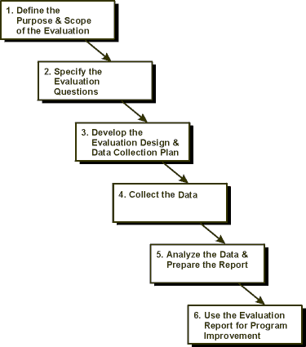
Basic Steps in Evaluation
Chapters in Worthen et al. 2003
Clarifying the Evaluation Requests & Responsibilities
Setting Boundaries & Analyzing the Evaluation Context
Focus the Evaluation: Identifying & Selection Evaluation Questions & Criteria
Develop a plan to conduct evaluation –- Evaluation Design & Data Collection Strategy
Conduct Study
Analyze Data
Write Report

Slide 12
Define the Purpose and Scope
The first step is to define the purpose and scope of the evaluation.
This is required in order to set limits to the evaluation, confining it to a manageable size.
This step also involves deciding on the goals and objectives for the evaluation.
As well as the audience for the evaluation results

Slide 13
Define the Purpose and Scope
The audience for evaluation may be very restricted (primarily internal) or may include a wide range of stakeholders and the general public.
The scope of the evaluation will depend on the evaluation's purpose and the information needs of the intended audience.
For example, it is appropriate to design a limited evaluation if the programme has already been evaluated and to target only certain parts of the program which have been changed, revised, or modified or only on certain objectives previously only partially achieved.

Slide 14
Focus the Evaluation
Most frequently this step is done through the development of a set of evaluation questions.
In turn the evaluation questions will influence choices of model and in the “evaluation design”

Slide 15
Focus the Evaluation
Developing evaluation questions requires that the object of the evaluation is fully described and discussions held with stakeholders.
Evaluation questions should be prioritized and examined in relation to the time and resources available.

Slide 16
Sample Evaluation Questions

Slide 17
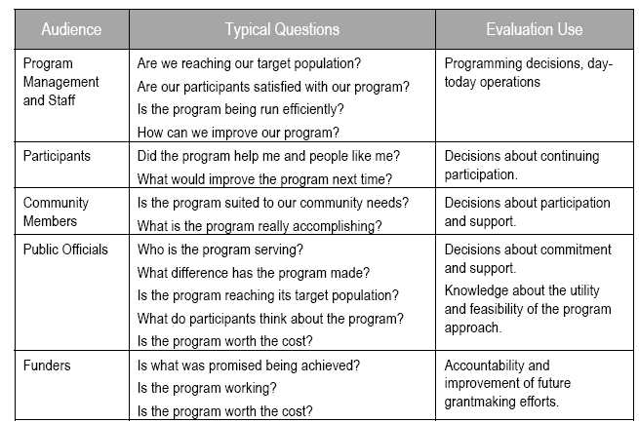

Slide 18
Types of Questions (CIPP Framework)
Context questions
are written to identify needs of target populations and opportunities to address those needs/ to determine how well project goals address stated needs
Input questions
are written to define capabilities, project strategies and designs, the goals (e.g., equipment, facilities, staff)
Process questions
are written to define deficiencies in the process or implementation, how were resources allocated, and what barriers threaten success
Product questions
are written to define outcomes, judge their worth, and describe lessons learned from the project.

Slide 19
Action Questions?
'Action' or improve questions deal with matters the project team can readily respond to, to rectify or improve an aspect of the innovation.
Other questions might focus on more general or 'big picture' outcomes not as directly linked to action. Some of these may be ‘prove questions’.
It is important to ask both specific, action-oriented as well as more general, 'big picture’ type questions.

Slide 20
High-value questions?
Some questions are particularly useful to ask because of their high 'pay-off‘.
For these questions,
little other information in the area
answers are of great interest to the major stakeholders
answers will inform or highlight areas that can readily be improved
Answers are feasibly obtained given the time and resources available.

Slide 21
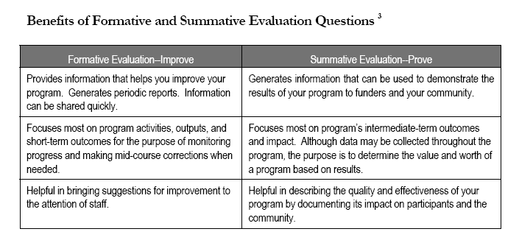
‘Prove’ & ‘improve’ questions
http://www.publichealth.arizona.edu/chwtoolkit/PDFs/Logicmod/chapter4.pdf#search=%22evaluation%20%2B%20logic%20model%22

Slide 22
Strategy for obtaining questions
Theory-Driven Models and logic modelling have a built in mechanism for developing EQs
However, logic models may be used in other approaches.

Slide 23
Strategy for obtaining questions
Logic Models illustrates the purpose and content of your program and makes it easier to develop meaningful evaluation questions from a variety of program vantage points: context, implementation and results (which includes outputs, outcomes, and impact).

Slide 24
Framing questions using the logic model

Slide 25
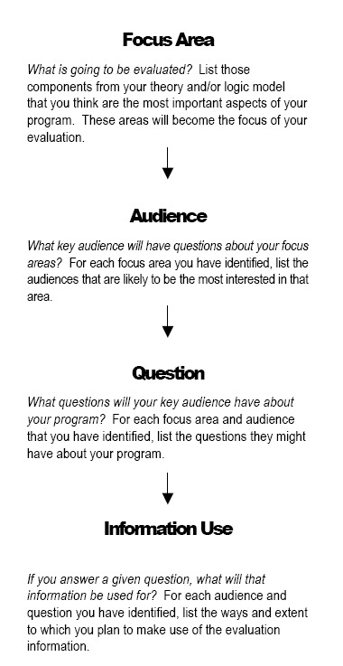

Slide 26
On logic models
The term "logic model" comes from evaluation, but as the term suggests, they are a basic element of programming that communicates the logic behind a program.

Slide 27
On logic models
A logic model’s purpose is to communicate the underlying "theory" or set of assumptions or hypotheses that program proponents have about why the program will work, or about why it is a good solution to an identified problem.

Slide 28
What do logic models look like
Logic models are typically diagrams, flow sheets, or some other type of visual schematic conveying relationships between contextual factors and programmatic inputs, processes, and outcomes. The scheme shows links in a chain of reasoning about "what causes what," in relationship to the desired outcome or goal. The desired outcome or goal is usually shown as the last link.

Slide 29
How to develop a Logic Model
Review and clarify the links between activities and outcomes (impacts).
Add inputs and outputs for each activity.
Construct a draft model.
Review and revise.

Slide 30
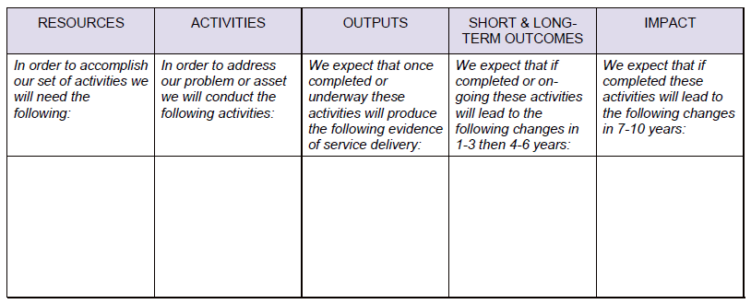
Use a logic model framework

Slide 31
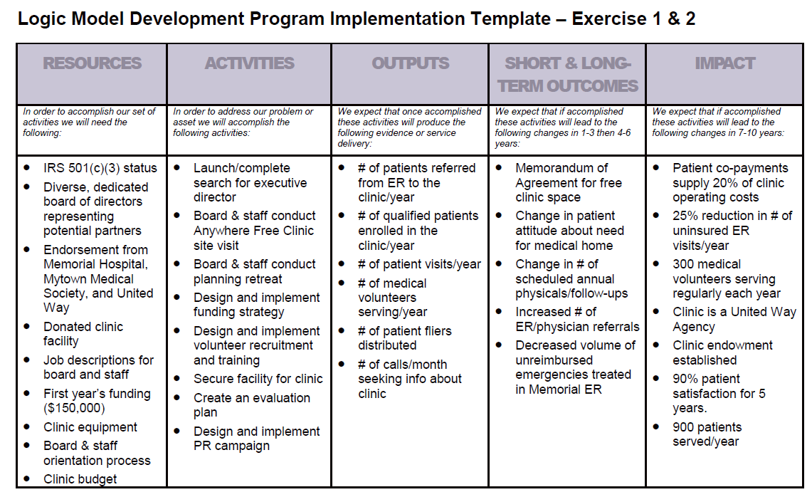

Slide 32
Evaluating the evaluation questions
Who will use the information?
Would an answer reduce the present uncertainty?
Would an answer yield important information?
Is this question merely of passing interest
Would the omission of the question limit the scope of the evaluation?
Will the answer impact the course of events?
Is it feasible to answer this question given the real life constraints?

Slide 33
Other ways to focus an evaluation
Criteria, indicators, and standards are often used in Quantitative Evaluations
Along with each question, multiple criteria may be specified and used to judge the program.
Indicators can then be developed for each criteria
The level of performance expected on each indicator may also be specified. This is considered a standard or benchmark

Slide 34
Definitions
A criterion is an attribute or activity necessary to fulfill evaluation objectives and overall goals – e.g. performance on the national mathematics assessment

Slide 35
Definitions
An indicator is a continuous factor used to describe a construct of interest. It is a quantitative or qualitative measure of programme performance which demonstrates change and which details the extent to which programme results are being or have been achieved. - e.g. the number of students in each category of performance on the national mathematics assessment

Slide 36
Definitions
Standards are descriptors used to describe the performance level associated with a particular rating or grade on a given criterion or dimension of achievements.
Standards are based on indicators and will answer the question “How good is good enough?” e.g. 75% of the school’s students will be in the advanced and proficient categories in the state mathematics assessment

Slide 37
Samples
http://www.seirtec.org/_evaluation/eval2.html

Slide 38
Differentiating Questions, Criteria, Indicators

Slide 39
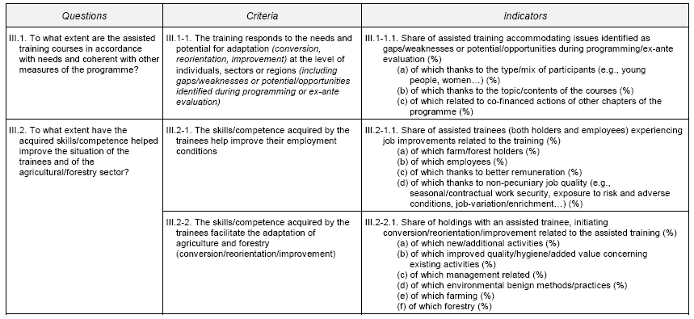
Questions, Criteria, Indicators
http://ec.europa.eu/agriculture/rur/eval/evalquest/b_en.pdf#search=%22evaluation%20questions%2C%20indicators%2C%20standards%2C%20criteria%22

Slide 41
From Questions to Design (& beyond)

Slide 42
From questions to design

Slide 43
From Questions to design
Guskey, T. R. (2000). Evaluating Professional Development. Thousand Oaks, CA: Corwin Press. See http://www.gse.harvard.edu/hfrp/eval/issue32/qanda.html

Slide 44
Defining “Evaluation Design”
An evaluation design is a detailed specification of the strategy used to collect data, including the groups to study, the units in the group, how the units will be selected, and the time intervals at which they are studied
See http://www.nsf.gov/ehr/rec/evaldesign.jsp

Slide 45
Models and Approaches
Different evaluation designs are usually associated with specific models. Full Evaluation Models are discussed in the Stufflebeam (2002).

Slide 46
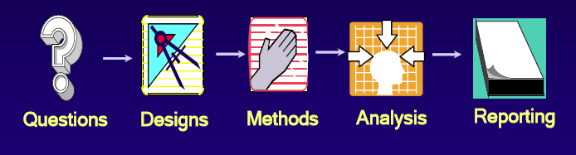
Relationship between evaluation design & approaches
Overall Evaluation Approach
Evaluation Design

Slide 47
Selected Models & Approaches
Behavioural Objectives Approach. This approach focuses on the degree to which the objectives of a program, product, or process have been achieved. The major question guiding this kind of evaluation is, “Is the program, product, or process achieving its objectives?”

Slide 48
Selected Models & Approaches
Responsive Evaluation. This approach calls for evaluators to be responsive to the information needs of various audiences or stakeholders. The major question guiding this kind of evaluation is, “What does the program look like to different people?”

Slide 49
Selected Models & Approaches
Consumer-Oriented Approaches. The emphasis of this approach is to help consumers choose among competing programs or products. The major question addressed by this evaluation is, “Would an educated consumer choose this program or product?”

Slide 50
Selected Models & Approaches
Utilization-Focused Evaluation. According to Patton (1997), “utilization focused program evaluation is evaluation done for and with specific, intended primary users for specific, intended uses” (p. 23). Stakeholders have a high degree of involvement. The major question is:“What are the information needs of stakeholders, and how will they use the findings?”

Slide 51
Selected Models & Approaches
Empowerment Evaluation. This approach, as defined by Fetterman (2001), is the “use of evaluation concepts, techniques, and findings to foster improvement and self-determination” (p. 3). The major question characterizing this approach is, “What are the information needs to foster improvement and self-determination?”

Slide 52
Selected Models & Approaches
Theory-Driven Evaluation. This approach to evaluation focuses on theoretical rather than methodological issues. The basic idea is to use the program’s rationale or theory to understand the program’s development and impact. The major focusing questions are, “How is the program supposed to work? What are the assumptions underlying the program’s development and implementation?”

Slide 53
Selected Models & Approaches
Expertise/Accreditation Approaches. The accreditation model relies on expert opinion to determine the quality of programs. The purpose is to provide professional judgments of quality. The question addressed in this kind of evaluation is, “How would professionals rate this program?”

Slide 54
Selected Models & Approaches
Goal-Free Evaluation. This approach focuses on the actual outcomes rather than the intended outcomes of a program. Thus, the evaluator has minimal contact with the program managers and staff and is unaware of the program’s stated goals and objectives. The major question in this kind of evaluation is, “What are all the effects of the program, including any side effects?”

Slide 55
Evaluation Designs
Quantitative
Experimental
Quasi-Experimental
Non-Experimental
Qualitative
Case Study
Grounded Theory
Mixed Methods

Slide 56
Choosing Evaluation Designs
In studies of what works, critical question of the quality of evidence.
Need to consider causal links in evaluating intervention effectiveness
Manage validity threats

Slide 57
Quantitative Evaluation Designs
There is no perfect design
Each design has strengths and weaknesses
There are always trade-offs – time, costs, practicality
Acknowledge trade-offs and potential weaknesses
Provide some assessment of their likely impact on your results and conclusion

Slide 58
Quasi & Experimental Designs
Quasi-experimental designs
Strategy #1: Add a control group
Strategy #2: Take more measurements (time series designs)
Strategy #3: Stagger the introduction of the intervention
Strategy #4: Reverse the intervention
Strategy #5: Measure multiple outcomes
Experimental designs
Experimental designs with “before” and “after” measurements
Experimental designs with “after”-only measurements

Slide 59
Experimental Evaluation Designs
Experimental Designs all share one distinctive element- random assignment to treatment and control groups.

Slide 60
Experimental Evaluation Designs
Experimental design is the strongest design choice when interested in establishing a cause-effect relationship. Experimental designs for evaluation prioritize the impartiality, accuracy, objectivity, and validity of the information generated. These studies look to make causal and generalizable statements about a population or impact on a population by a program or initiative.

Slide 61
Quasi-Experimental Designs
Most quasi-experimental designs are similar to experimental designs except that the subjects are not randomly assigned to either the experimental or the control group, or the researcher cannot control which group will get the treatment.
Like the experimental designs, quasi-experimental designs for evaluation prioritize the impartiality, accuracy, objectivity, and validity of the information generated. These studies look to make causal and generalizable statements about a population or impact on a population by a program or initiative.
Types of quasi-experimental designs include: comparison group pre-test/post-test design, time series and multiple time series designs, multiple time series designs, non-equivalent control group, and counterbalanced designs.

Slide 62
Quasi-Experimental Designs
Quasi-experimental designs also prioritize the impartiality, accuracy, objectivity, and validity of the information generated. These studies look to make causal and generalizable statements about a population or impact on a population by a program or initiative.

Slide 63
Quasi-Experimental Designs
Types of quasi-experimental designs include: comparison group pre-test/post-test design, time series and multiple time series designs, multiple time series designs, non-equivalent control group, and counterbalanced designs.

Slide 64
Non Experimental Quan Designs
Includes “causal-comparative”, correlational and case study (and multi-site case studies) designs.
Also include mixed methods research designs.
Common in theory driven evaluation

Slide 65
Mixed Method Designs
Several typologies currently available – Most popular are Creswell and Plano Clarke (2007, 2010) and Teddlie and Tashakkori (2009)
Weight, emphasis, timing, and strands are important in classifications

Slide 66
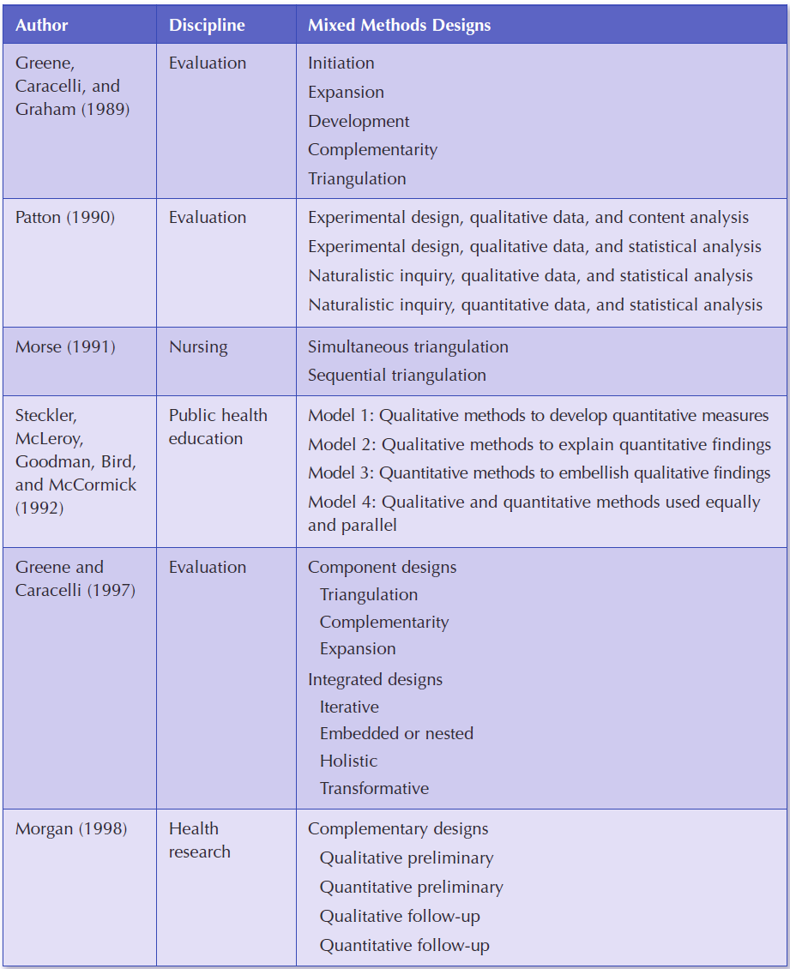

Slide 67
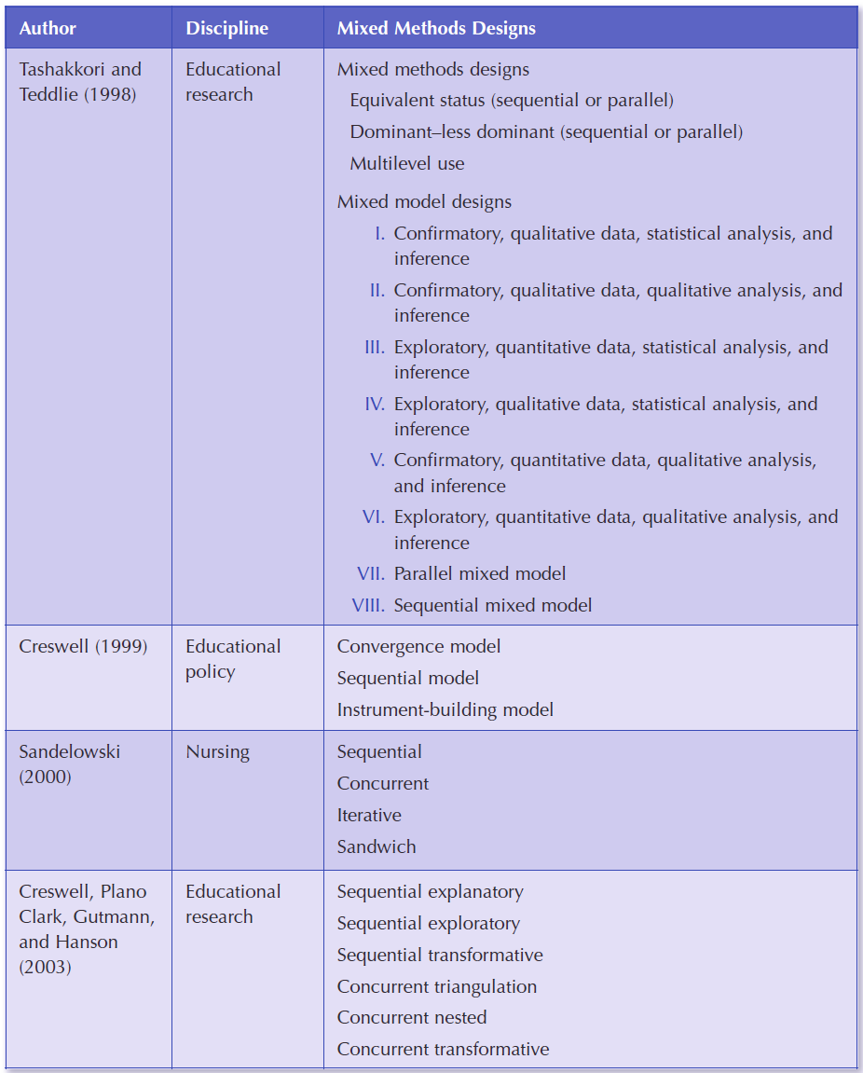

Slide 68
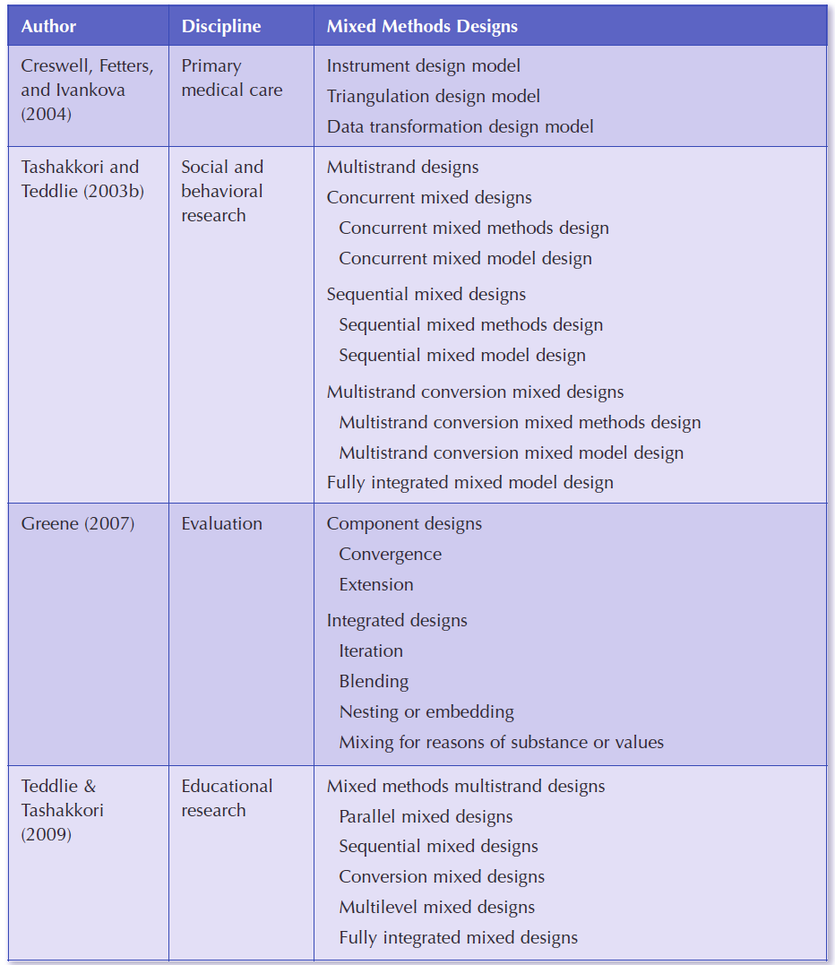

Slide 69
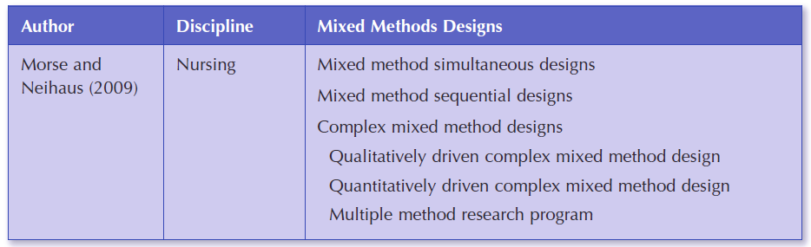

Slide 70
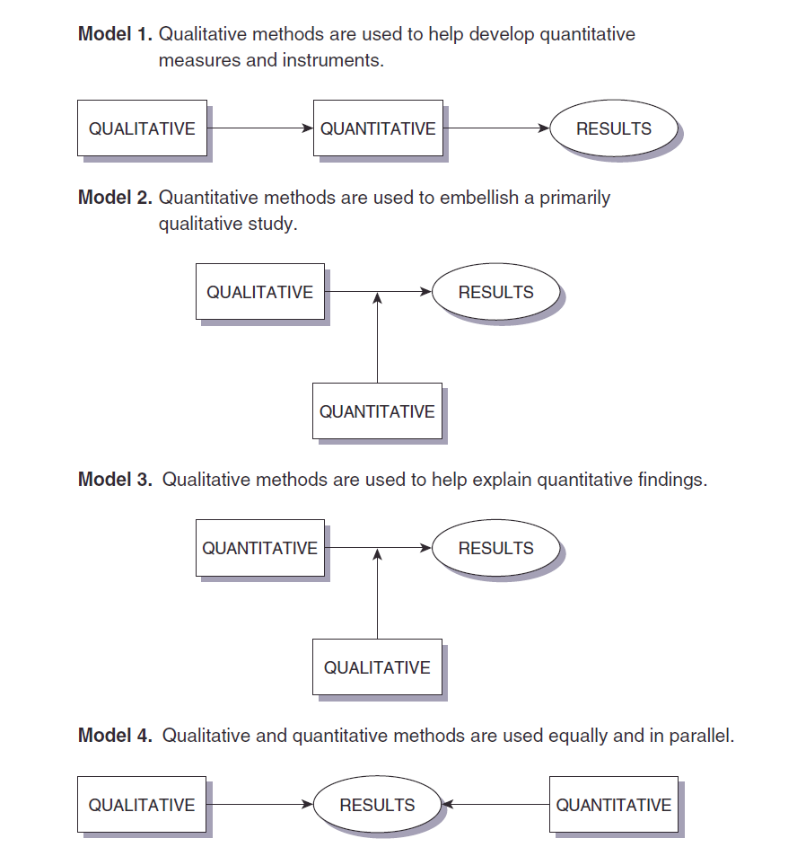

Slide 71
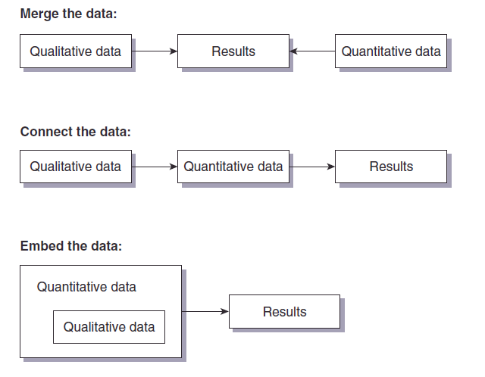

Slide 72
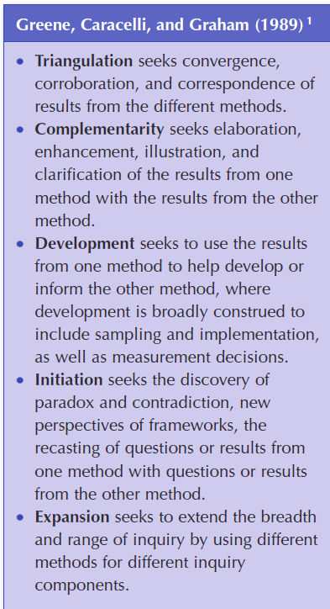

Slide 73
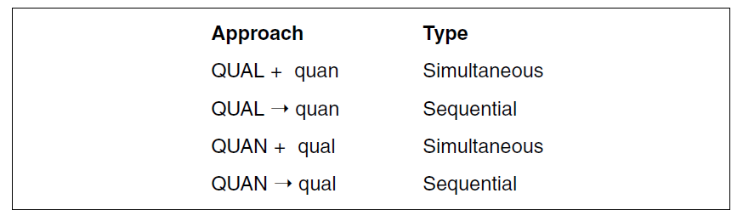

Slide 74
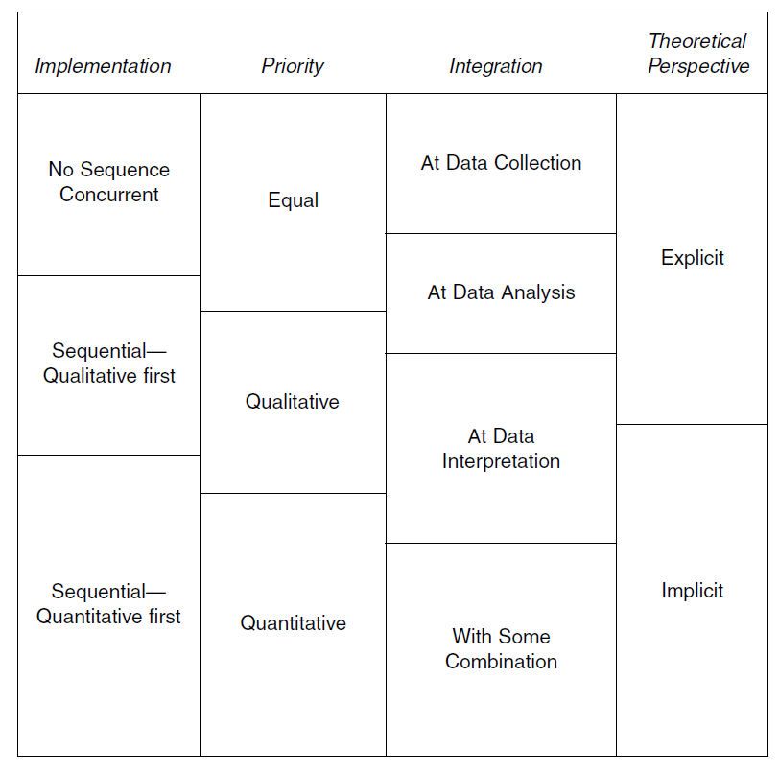

Slide 75
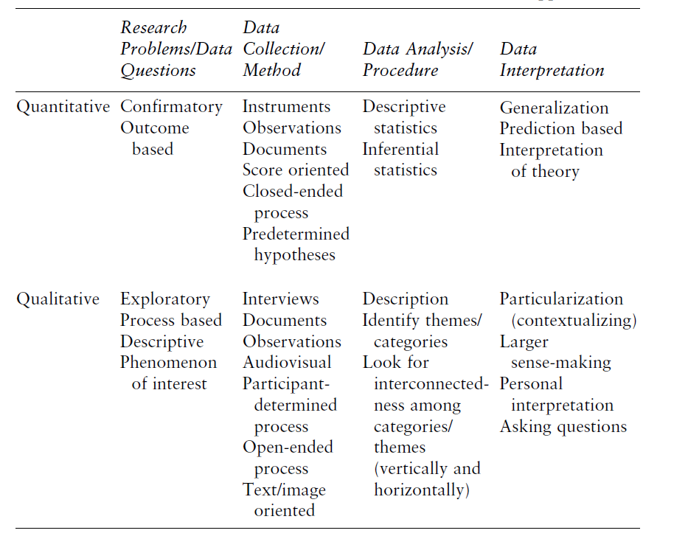

Slide 76
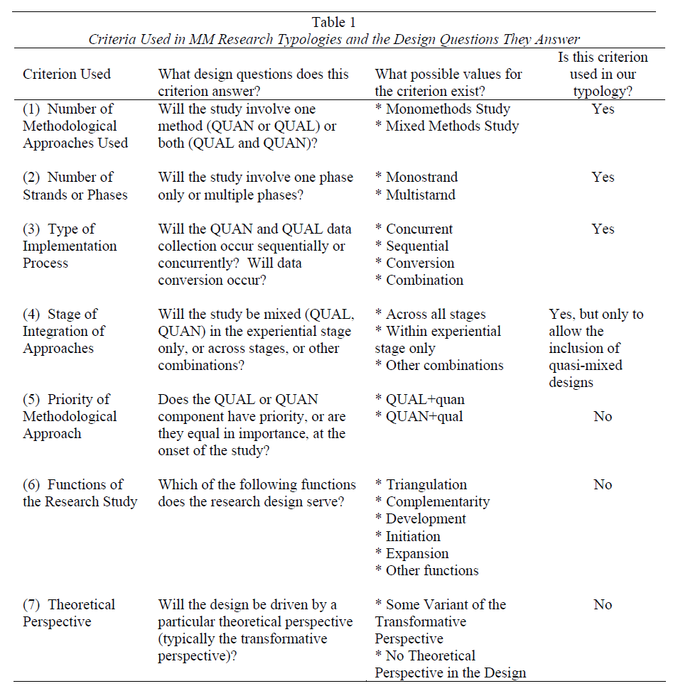

Slide 77
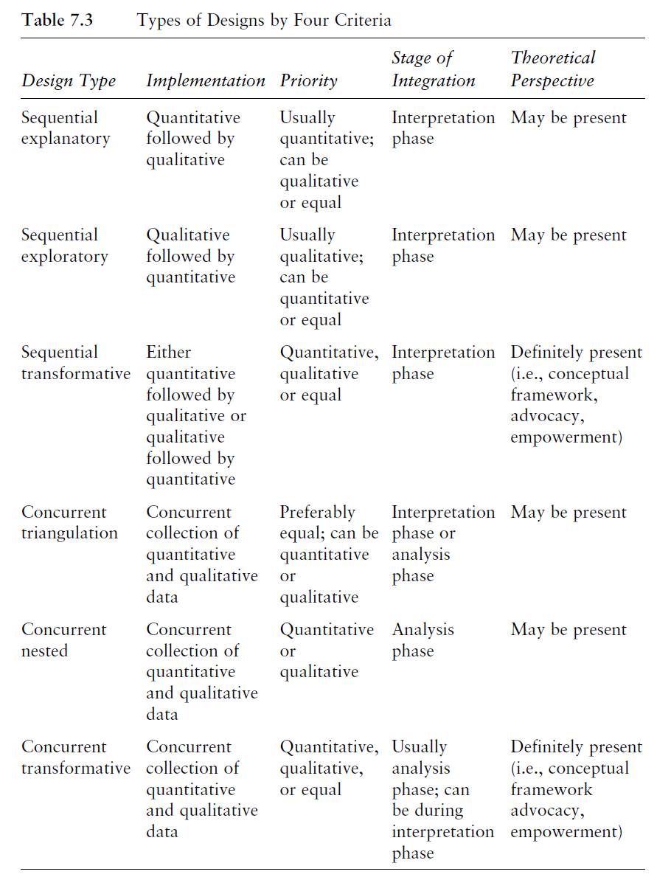

Slide 78
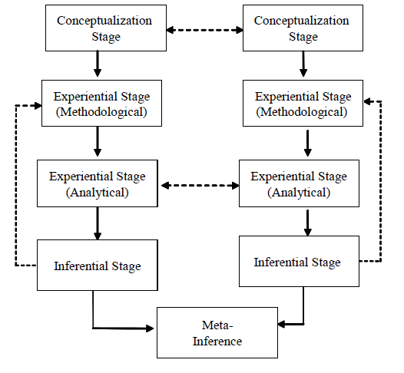
Specific Designs: Concurrent/ Parallel (Teddlie & Tashakkori)

Slide 79
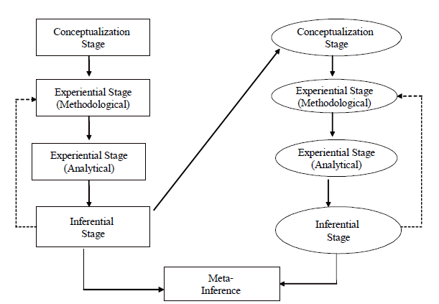
Specific Designs: Sequential

Slide 80
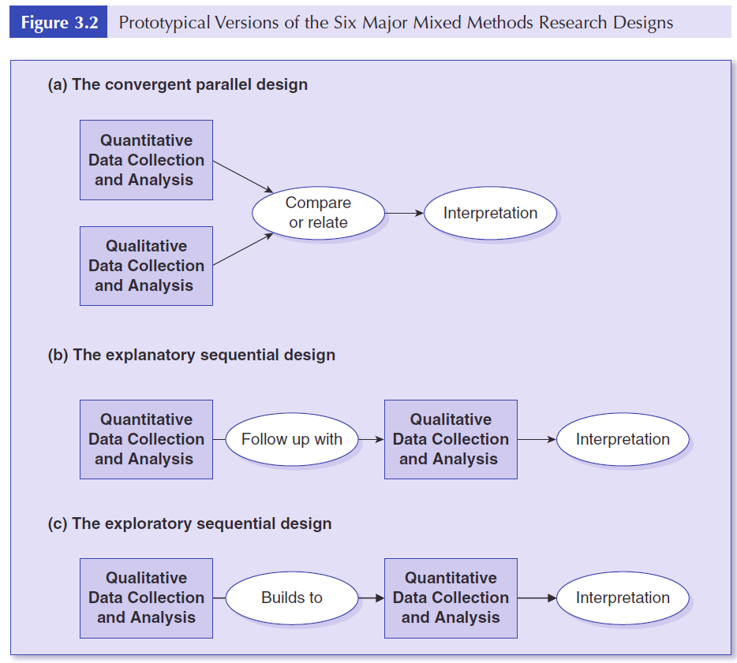

Slide 81
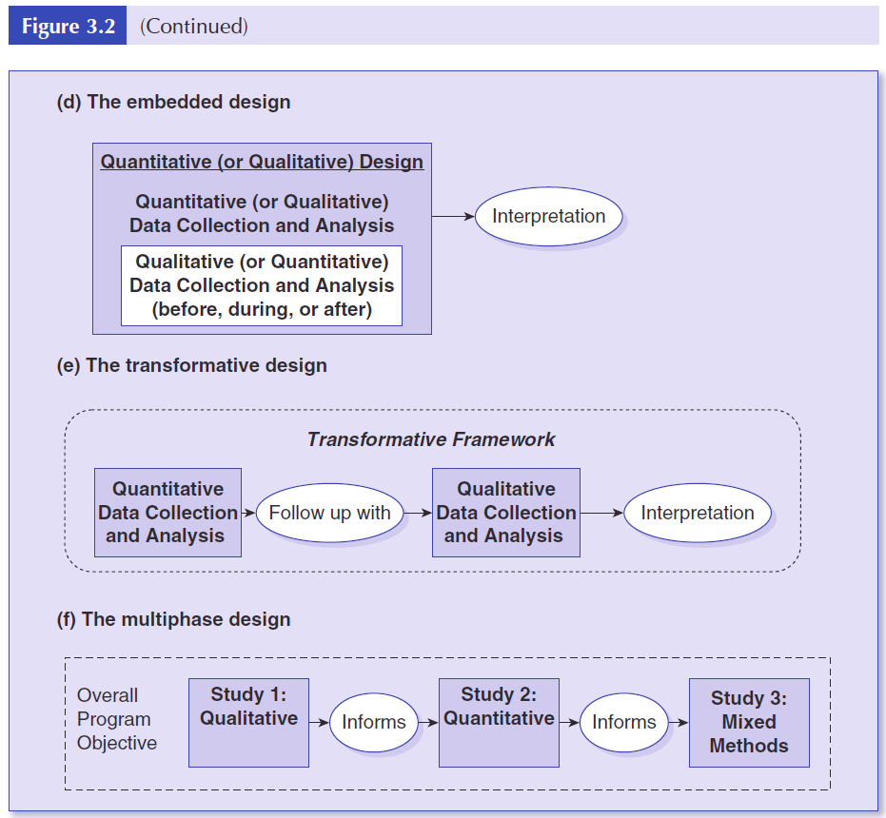

Slide 82
Practical steps in developing an evaluation design
Your evaluation design plan may be presented to the sponsor.
An evaluation design matrix should be developed

Slide 83
Evaluation Design Plan
Must include
collecting data
analyzing data
reporting results
getting the results used

Slide 84
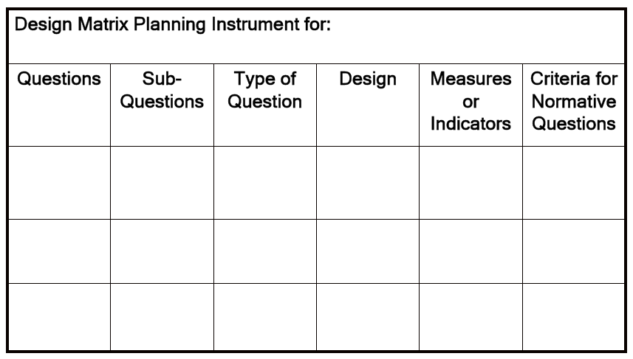
Using a Design Matrix

Slide 85
Developing an Evaluation Design
Identify the question(s) to be addressed
Select measurement instruments & data sources
Select a model and/or design,
Select a sample
Develop an analysis plan
Develop a timeline for study implementation.

Slide 86
Identify the question(s) to be addressed
Your evaluation questions are the centerpiece of the evaluation.
They are used to develop criteria and indicators as well as measurement instruments/data collection strategies
Different evaluation models focus on different question types

Slide 87
Select measurement instruments & data sources
There are multiple ways of answering most questions.
Generally evaluators seek information from multiple sources

Slide 88
Select a model and/or design
The design you choose depends to a considerable extent on the question you are trying to address and the level of rigour that is required.
Sampling is a critical factor that may be neglected impacting on generalizability.
Choose a model that captures your intention best.
Models are considered in the key texts.

Slide 89
Develop an analysis plan
Always specify upfront how you will analyze the data that you will be collecting - especially in quantitative studies

Slide 90
Develop a timeline for study implementation
Develop a timeline for designing or selecting your instruments, collecting your data, and reporting.
Don’t be over-optimistic with the timelines

Slide 91
Reporting & Communicating
There is a need to organize and consolidate the final report
Sections
Background (the project’s objectives and activities);
Evaluation questions (meeting stakeholders’ information needs);
Methodology (data collection and analysis);
Findings
Conclusions (and recommendations).

Slide 92
Evaluating the evaluation report
A well-written report should provide a concise context for understanding the conditions in which results were obtained as well as identify specific factors that affected the results.
It is necessary to balance description with interpretation and analysis.
recommendations should express views based on the total project experience

Slide 93
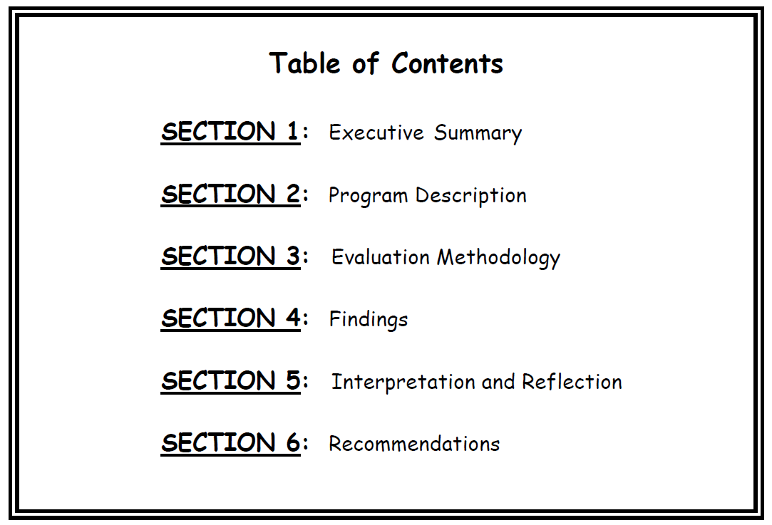

Slide 94

The Players-Jennifer Greene

Slide 95
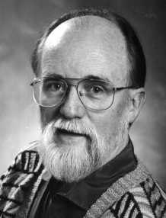
The Players-Michael Q. Patton
My name is Michael Quinn Patton and I am an independent evaluation consultant. That means I make my living meeting my clients’ information needs. Over the last few years, I have found increasing demand for innovative evaluation approaches to evaluate innovations. In other words, social innovators and funders of innovative initiatives want and need an evaluation approach that they perceive to be a good match with the nature and scope of innovations they are attempting. Out of working with these social innovators emerged an approach I’ve called developmental evaluation that applies complexity concepts to enhance innovation and support evaluation use.

Slide 96

The Players- Daniel Stufflebeam
Founder and director, Ohio State University Evaluation Center, 1963-73
Dr. Daniel L. Stufflebeam has wide experience in evaluation, research, and testing. He holds a Ph.D. from Purdue University and has held professorships at The Ohio State University and Western Michigan University.
He directed the development of more than 100 standardized achievement tests, including eight forms of the GED Tests; led the development of the evaluation field's Program and Personnel Evaluation Standards; established and directed the internationally respected Evaluation Center, directed the federally funded national research and development center on teacher evaluation and educational accountability, and developed the widely used CIPP Evaluation Model. He has conducted evaluations throughout the U.S., and in Asia, Europe, and South America.
His clients have included foundations, universities, colleges, school districts, government agencies, the U.S. Marine Corps, a Catholic Diocese, and others. He has served as advisor to many federal and state government departments, the United Nations, World Bank, Open Learning Australia, several foundations, and many other organizations.

