Slide 1
Lecture Series 2: Standards & Specifications for Assessments & Items
© Jerome De Lisle, 2007 Updated 2010

Slide 2
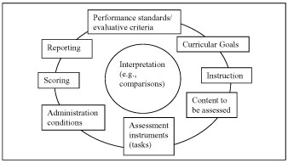
The process of Test Development

Slide 3
The context
After noting that test development begins with items, Embretson & Gorin (2001) pointed out that “traditionally, item design is viewed primarily as an art. Item specifications are vague. Test developers employ item specifications that often contain only general content considerations or vaguely described processing levels (p. 343)”

Slide 4
Test Development
Is the process of creating an assessment in any format or mode.
It requires 12 discrete steps in four categories:
DESIGN
DEVELOPMENT
ADMINISTRATION
SCORING & EVALUATION

Slide 5
TEST DEVELOPMENT
Overall Plan
Content Definition
Test Specifications
Item Development
Test Design & Assembly
Test Production
Test Administration
Scoring Test Responses
Standard Setting
Score Reporting
Item Banking
Writing Technical Report

Slide 6

Standards & Specifications

Slide 7
Definitions
STANDARD- is a guideline or documentation that reflects agreements on products, practices, or operations by nationally or internationally recognized industrial, professional, trade associations or governmental bodies.
Note: This concept applies to formal, approved standards, as contrasted to de facto standards and proprietary standards, which are exceptions to this concept.

Slide 8
Definitions
STANDARD- An exact value, a physical entity, or an abstract concept, established and defined by authority, custom, or common consent to serve as a reference, model, or rule in measuring quantities or qualities, establishing practices or procedures, or evaluating results.

Slide 9
Definitions-Types of Standards

Slide 10
Standards Governing Assessment Practice
The Standards for Educational and Psychological Testing govern assessment practice and were developed jointly by the following organizations:
American Educational Research Association (AERA)
American Psychological Association (APA)
National Council on Measurement in Education (NCME)

Slide 11
Standards
There have been five earlier documents from these three sponsoring organizations providing standards to guide the development and use of educational and psychological tests-

Slide 12
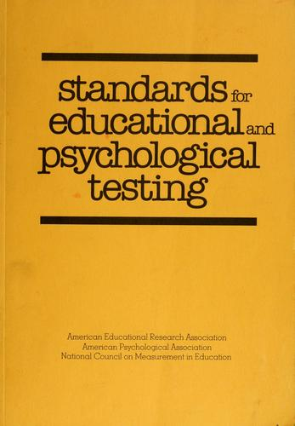

Slide 13
Standards
Earlier Work
APA (1954) Technical recommendations for psychological tests and diagnostic techniques
AERA, NCME (1955) Technical Recommendations for Achievement tests
APA, AERA, NCME (1966) Standards for Educational and Psychological Tests & Manuals

Slide 14
Standards
Earlier Work
APA, AERA, NCME (1974) Standards for Educational and Psychological Tests
APA, AERA, NCME (1985) Standards for educational and psychological testing.

Slide 15
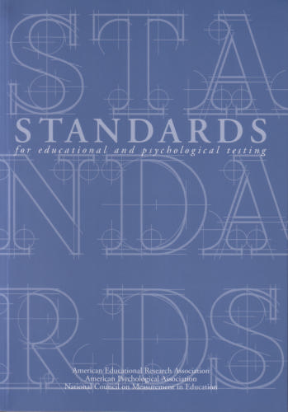
The Latest Standards

Slide 16
The Latest Standard
The new Standards reflects changes in US federal law and measurement trends affecting validity testing individuals with disabilities or different linguistic backgrounds; new types of tests as well as new uses of existing tests.
(APA Web site)

Slide 17
The Latest Standard
In the 1994 document there were 264 standards (as opposed to 180 in the 1999 version)
Most standards have explanatory text as the chapters in the text

Slide 18
The Latest Standard
The ‘Standards’ are written for the professional and for the educated layperson and addresses professional and technical issues of test development and use in education, psychology and employment.

Slide 19
Revision of the 1999 Standards
The 1999 Standards are in the process of final revision and will be discussed at the 2011AERA/NCME Meeting

Slide 20
The Latest Standards -Organization & Content
Part I: Test Construction, Evaluation, & Documentation
Part II: Fairness in Testing
Part III: Testing Applications

Slide 21
The Latest Standards Organization & Content
Part I: Test Construction, Evaluation, and Documentation
Validity
Reliability and Errors of Measurement
Test Development and Revision
Scales, Norms, and Score Comparability
Test Administration, Scoring, and Reporting
Supporting Documentation for Tests

Slide 22
The Latest Standards Organization & Content
Part II: Fairness in Testing
Fairness in Testing and Test Use
The Rights and Responsibilities of Test Takers
Testing Individuals of Diverse Linguistic Backgrounds
Testing Individuals with Disabilities

Slide 23
The Latest Standards Organization & Content
Part III: Testing Applications
The Responsibilities of Test Users
Psychological Testing and Assessment
Educational Testing and Assessment
Testing in Employment and Credentialing
Testing in Program Evaluation and Public Policy

Slide 24
Standards & Test Development
Overall Plan – 1.1/3.2/3.9
Content Definition-1.6/3.2/3.11
Test Specifications-1.6/3.2/3.3-4
Item Development-3.6/3.7//3.17/7.2
Test Design & Assembly-3.7/3.8
Test Production- NONE
Test Administration-3.18/3.19/3.20/3.21
Scoring Test Responses-3.6/3.22
Standard Setting-4.10/4.11/4.19/4.20
Score Reporting-8.13/ 11.6/ 11.12/ 11.15/ 13.19 /15.10/15.11
Item Banking-6.4
Writing Technical Report-3.1/6.5

Slide 25
Other Current Standards for Assessment Practice
CODE OF FAIR TESTING PRACTICES IN EDUCATION
Prepared by the Joint Committee on Testing Practices
The Code of Fair Testing Practices in Education ( Code ) is a guide for professionals in fulfilling their obligation to provide and use tests that are fair to all test takers regardless of age, gender, disability, race, ethnicity, national origin, religion, sexual orientation, linguistic background, or other personal characteristics.

Slide 26
2014 Revision of the Standards
Differences Between the 1999 Version and the New Version
In response to comments received at various stages of the revision process, the new version of the Standards includes updated material on such topics as educational accountability and technological advances in testing and a reworking of chapters concerning workplace testing and credentialing.
The overall organization of the revised Standards is also different from that of the 1999 edition. The new version is separated into “Foundations,” “Operations” and "Testing Applications” sections. The “Foundations” section focuses on fundamental testing issues such as validity, reliability and fairness. The “Operations” section deals with operational testing issues such as test design and development, test administration, scoring and reporting and supporting documentation for tests. The “Testing Applications” section details specific applications in testing such as workplace testing and credentialing, educational testing and assessment, and the use of tests for program evaluation, policy studies and accountability.
While several chapters in the 1999 edition addressed fairness, the new edition both expands that material and integrates it into a single “foundations” chapter. The joint committee decided on this approach after concluding that the issue of fairness was so fundamental to testing practice that it should be considered as a foundation of testing along with validity and reliability.

Slide 27
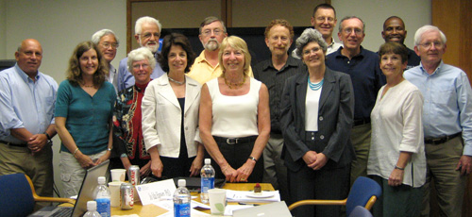
Members of the 2014 Joint Committee. (Top row, left to right): Brian Gong, Laurie Wise, Fritz Drasgow, Michael Kolen, Denny Way, Paul Sackett, Frank Worrell. (Bottom row, left to right): Antonio E. Puente, Laura Hamilton, Barbara Plake, Joan Herman, Linda Cook, Nancy Tippins, Jo-Ida Hansen, Michael Kane

Slide 28
Other Current Standards for Assessment Practice
CODE OF FAIR TESTING PRACTICES IN EDUCATION
Fairness is a primary consideration in all aspects of testing. Careful standardization of tests and administration conditions helps to ensure that all test takers are given a comparable opportunity to demonstrate what they know and how they can perform in the area being tested.
Fairness implies that every test taker has the opportunity to prepare for the test and is informed about the general nature and content of the test, as appropriate to the purpose of the test.
Fairness also extends to the accurate reporting of individual and group test results.
Fairness is not an isolated concept, but must be considered in all aspects of the testing process.

Slide 33

Your Assignment

Slide 34
Writing a Purpose & Rationale for Your Test
The RATIONALE is the –
“1. fundamental reasons for the exercise; the basis of the project. 2. An exposition of principles or reasons”.
The PURPOSE is the
“The object toward which one strives or for which something exists; an aim or a goal “

Slide 35
Writing a Purpose & Rationale for Your Test/Assessment
Questions to ask
What will the test do-formative/summative/diagnostic?
Why are you using this particular design specifications and items?
Why did you make the choices you did in the design specifications, development, and implantation?
How is the aligned with the classroom system identified?

Slide 36
Sample

Slide 37
Sample

Slide 38
Sample (continued)

Slide 39
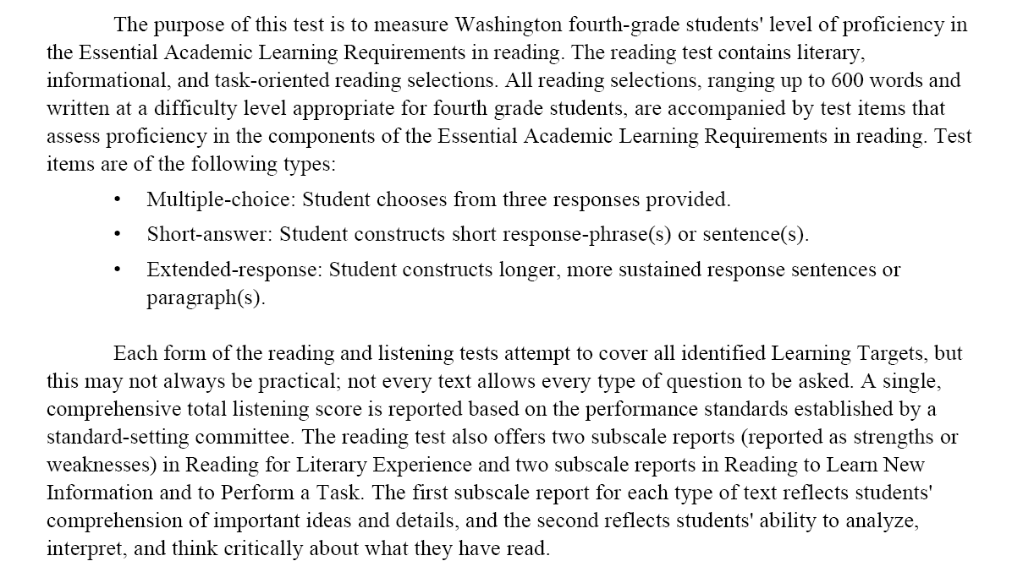
Sample

Slide 40
Specifications
Specifications- are a detailed, exact statement of particulars, especially a statement prescribing materials, dimensions, and quality of work for something to be built, installed, or manufactured.

Slide 41
Test Specifications
The 1999 Standards (Standard 1.6) encourages test writers to prepare a blueprint of the test, which would indicate the numbers of items or tasks and the content area being sampled.
This device will ensure content validity (appropriate and adequately sampled content)

Slide 42
Sample Question
A table of specifications (test blueprint) is most likely a component of the evidence for which ONE of the following aspects of test validity?
(A) content
(B) criterion
(C) predictive
(D) concurrent
(E) consequential

Slide 43
Sample Question
A medical student challenges his final year examination results on the grounds that the examination measured knowledge of content that was not taught, necessary or critical to good practice. What source of evidence must be considered by the judicial system in coming to a decision
(A) item specifications
(B) test specifications
(C) performance standards
(D) definition of minimum competence
(E) scoring scheme and rubrics

Slide 44
Item & test specifications

Slide 45
What is a table of specifications for?
A table of specifications or test blueprint is a basic step in planning an assessment.
It focuses not only on the chosen content, but also the level of questions written, ensuring alignment with course objectives

Slide 46
What is a table of specifications for?
The table of specifications includes both content and process dimensions and describes what the student must know (rows) and what he or she is to do with that knowledge (columns)

Slide 47
What is a table of specifications for?
It may be constructed as a matrix, but other designs are possible.
One important component of the table is the specification of the cognitive domain.
Standard 13.3 an 1.8 emphasizes that achievement tests must specify this information.

Slide 48
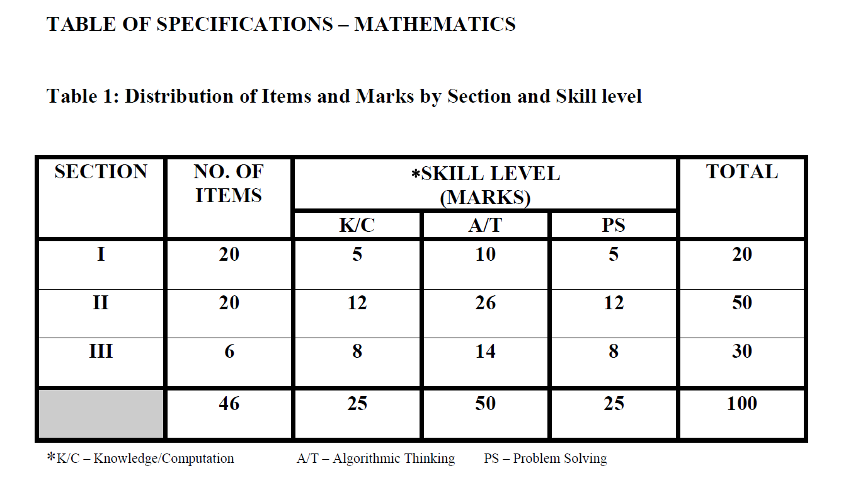
SEA Sample

Slide 49
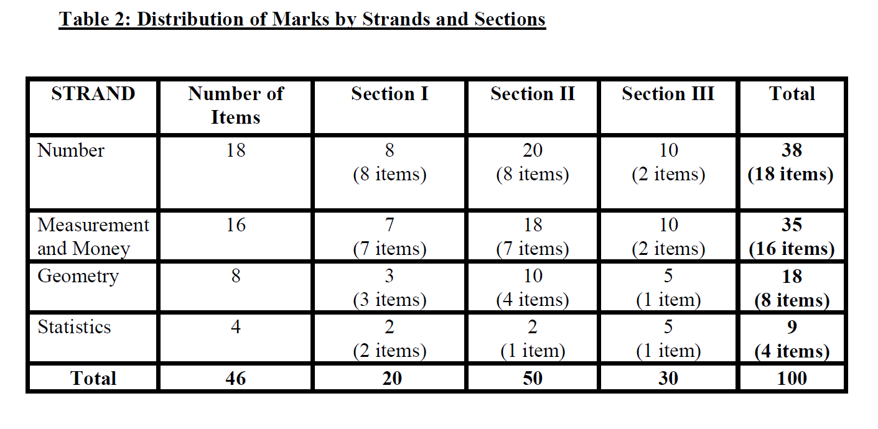

Slide 50
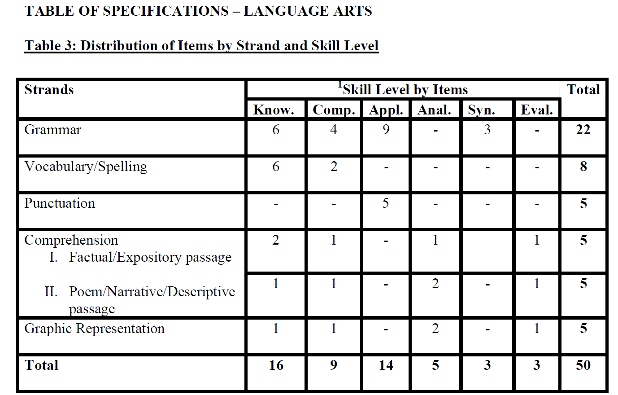

Slide 51
Specifying the Cognitive Domain
The table of specifications is a useful tool in item generation because it can reduce the tendency of writers to construct low level questions for written papers.
There should also be significant planning for performance assessments.

Slide 52
Specifying the Cognitive Domain
There is no need to use Bloom’s taxonomy exclusively in specifying the cognitive domain,
There are multiple classifications, the best (most widely applicable) being the three component – knowledge, comprehension, and problem-solving

Slide 53
Specifying the Cognitive Domain
The problem-solving- category (Strategic and extended thinking) better represents reality because it is difficult to distinguish tasks that elicit higher order skills (above application)
See Haladyna (2004)
Example on next page for 8th Grade math

Slide 57
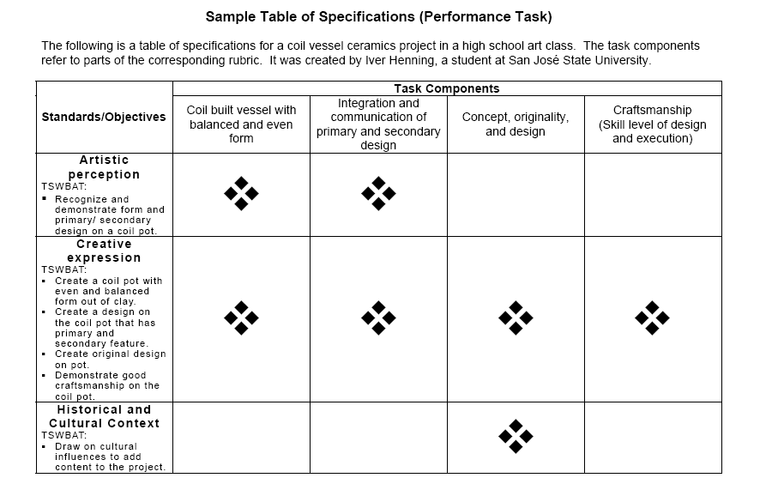

Slide 62
Item Specifications
While the test blueprint is a useful guide, the process can be made more explicit through item specifications.
Item specifications are detailed and precise descriptions of what each item or task will measure on the test, how that item or task will be presented, and the range of allowable content

Slide 63
Why Item specifications
Some tasks and items are not well thought out and students might respond in unexpected or unpredictable ways, as revealed by thinkalouds administered after the examinations.

Slide 64
Why Item specifications
Writing item specifications encourages the test constructor to think more deeply about what they intend to assess/measure and to explore various [alternative] ways of doing that.

Slide 65
The role of item specs
Serve as guide to item writers
Help in preparation of item banks
Tell teachers and students want is important to learn

Slide 66
The anatomy of item specs
A GENERAL DESCRIPTION OF WHAT IS TO BE MEASURED
TOPIC & OBJECTIVE
A DESCRIPTION/SET OF RULES FOR STATING THE PROBLEM
A DESCRIPTION OR SET OF RULES FOR HOW THE STUDENT MIGHT RESPOND
SAMPLE ITEM

Slide 67
Knowledge | Comprehension | Application | Analysis | Synthesis | Evaluation
define identify indicate know label list memorize name recall record relate repeat select underline | classify describe discuss explain express identify locate paraphrase recognize report restate review suggest summarize tell translate | apply compute construct demonstrate dramatize employ give examples illustrate interpret investigate operate organize practice predict schedule shop sketch translate use | analyze appraise calculate categorize compare contrast criticize debate determine diagram differentiate distinguish examine experiment inspect inventory question relate solve | arrange assemble collect compose construct create design formulate manage organize perform plan prepare produce propose set-up | appraise assess choose compare contrast decide estimate evaluate grade judge measure rate revise score select value

Slide 78
How good is the assessment?

Slide 79
Standards for Judging the Quality of Assessments
How do we evaluate assessments? What standards do we use?
These standards are found in the psychometric literature and documented in the Standards for Educational and Psychological Testing (current version released 2014).

Slide 80
Standards for Judging the Quality of Assessments
The most important standard is validity, which assumes that the test is reliable or consistent. The third traditional standard is usability. Fairness is increasingly seen as one of the big three that includes validity and reliability (See 2014 standards)

Slide 81
Reliability
Reliability means consistency across administration and users.
Reliability is related to the number of items in traditional test, but traditional indices, like Cronbach’s alpha may have little meaning for performance task, which are usually not generalizable.

Slide 82
Reliability (definition)
Test reliability refers to the degree to which a test is consistent and stable in measuring what it is intended to measure.
Most simply put, a test is reliable if it is consistent within itself and across time.

Slide 83
Usability
Usability means practicability – the ability to easily use and implement the assessment.
Cumbersome assessments are difficult to manage and create invalidity during administration

Slide 84
Validity as the most important standard?
The concept of validity has changed significantly over time and current conceptualizations are difficult for many to grasp.
Debates about test validity continue.

Slide 85
READING

Slide 86
Reading

Slide 87
Current Conceptions of Validity
Validity is about what the score from a test means- how we intend to interpret those meanings and whether those interpretations are appropriate and in line with our original purpose.

Slide 88
Reading

Slide 89
Reading

Slide 90
Thinkers on validity

Slide 91
Thinkers on Validity
1982 Photo

Slide 92

Michael Kane-An argument based approach to Validity

Slide 93
Validity
The understanding of validity as a static, “all or nothing” attribute is no longer in vogue.
The Trinity doctrine (construct, content, criterion) is also no longer accepted.
Instead some believe in the unitary concept of validity in which construct is the whole of validity and different aspects are types of evidence for the whole.

Slide 94
The 1999 Standards on Validity
“The degree to which evidence and theory support the interpretation of test scores entailed by proposed used of tests.” (AERA/APA/NCME, 1999).
This “new” definition differs from the classic one which talks about the test measuring what it is intended to measure – the focus here is on the test scores

Slide 95
Changing conceptions
The most important influences on the definitions of validity in the 1985 and 1999 standards come from the work of Lee J. Cronbach and Samuel Messick.
Future work is likely to be based on the conceptualization of Michael Kane and his argument-based approach to validity and validation.

Slide 97


Slide 98
Messick’s Definition
"…an integrated evaluative judgment of the degree to which empirical evidence and theoretical rationale support the adequacy and appropriateness of inferences and actions based on test scores and other modes of assessment."

Slide 99
Understanding Samuel Messick
To understand Messick’s writings we must appreciate that a test can never directly measure a construct, we can only infer about that construct from the results on the test.
Therefore we must collect evidence as in a court of law to prove the validity of our meanings and inferences from the test score.

Slide 100
Changing Conceptions of Validity
Unitary Concept
[current]
Inferences
&
Decisions
based
on the Score
[1966]
Use of the test
and test score
[1940]
The test
CONSEQUENCES OF USE

Slide 101
Changing Conceptions of Validity
Validity as Argument
Statement of claims
-overall evaluation of
intended interpretations
and uses of scores
[1960s]
Content based
validity
[1950]
Criterion based
validity
Construct validity
as the whole
Construct Validity

Slide 103
Validity Evidence?
Evidence for or against a degree of validity may come from
The structure of the test
The content of the test
The responses to the test
From variables that are supposed to be related (or not) to the test
CONVERGENT (Measure same)
DISCRIMINANT (Measure Different)
CRITERION (An external criterion of importance)
PREDICTIVE
CONCURRENT
From the consequences of test score use

Slide 104
Accumulating & Integrating Evidence

Slide 105
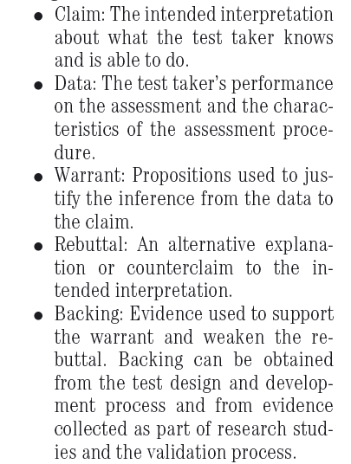
Components of a Validity Argument

Slide 106
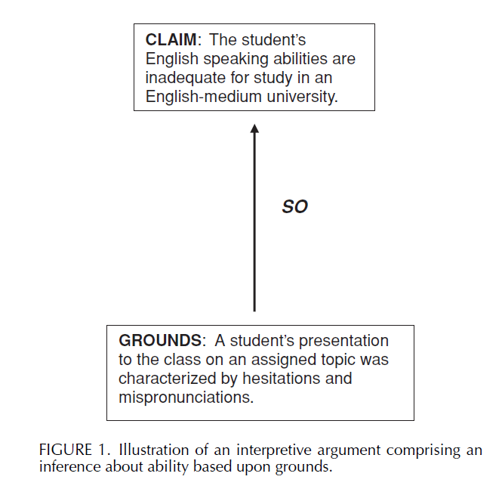

Slide 107
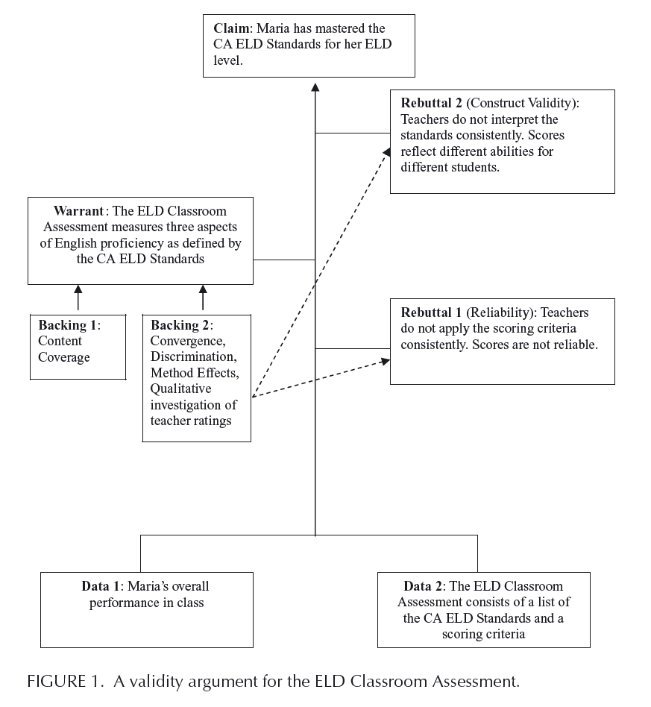

Slide 108
Expanded quality criteria for Performance Assessments

Slide 109
Expanded Criteria for Complex Assessments-the Authors

Slide 111
Expanded Criteria
Cognitive complexity
-the assessment task calls for complex intellectual activity such as problem solving, critical thinking, and reasoning
Content quality
-the assessment calls for students to demonstrate their knowledge of challenging and important subject matter
Meaningfulness
-the assessment tasks are worth students' time and students understand their value
Language appropriateness
-the language demands are clear and appropriate to the assessment tasks and to students

Slide 112
Expanded Criteria
Transfer and generalizability
-successful performance on the assessment task allows valid generalizations about achievement to be made; indicates ability to successfully perform other tasks
Fairness
-student performance is measured in a way that does not give advantage to factors irrelevant to school learning; scoring schemes are similarly equitable
Reliability
-answers to assessment questions can be consistently trusted to represent what students know
Consequences
-the assessment has the desired effects on children, teachers, and the educational system

Slide 113
Expanded Criteria
See http://www.gower.k12.il.us/Staff/ASSESS/4_ch2.htm
http://www.ed.gov/pubs/IASA/newsletters/assess/pt1.html

Slide 114
Sample Question
What is the current meaning of validity?
Explain how the concept of validity has changed over the last fifty years?

Slide 115
Sample Question
It is important to remember, however, that no test is valid for all purposes. Indeed, tests vary in their intended uses and in their ability to provide meaningful assessments of student learning. Therefore, while the goal of using large-scale testing to measure and improve student and school system performance is laudable, it is also critical that such tests are sound, are scored properly, and are used appropriately.
Some public officials and educational administrators are increasingly calling for the use of tests to make high-stakes decisions, such as whether a student will move on to the next grade level or receive a diploma. School officials using such tests must ensure that students are tested on a curriculum they have had a fair opportunity to learn, so that certain subgroups of students, such as racial and ethnic minority students or students with a disability or limited English proficiency, are not systematically excluded or disadvantaged by the test or the test-taking conditions. Furthermore, high-stakes decisions should not be made on the basis of a single test score, because a single test can only provide a "snapshot" of student achievement and may not accurately reflect an entire year's worth of student progress and achievement.
APA web site

Slide 116
Sample Question
Based on the above comment on some likely validity issues in (a) the use of national achievement tests and (b) placement tests at Eleven Plus.
Suggest workable strategies that might ameliorate the issues identified above.

Slide 117
Many Samples from
http://title3.sde.state.ok.us/studentassessment/testingmaterials.htm
http://nces.ed.gov/TIMSS/Educators.asp
Problem solving questions at
http://www.csd99.k12.il.us/north/library/links2004/math/problemsolving.htm

Slide 118
Presentation, Assembly, & Administration
There are different presentation rules for the different performance and written examinations
Some constructed response items require that the item developer specify the number of lines for response

Slide 119
Presentation, Assembly, & Administration
Context dependent MCQs should have be completed on the same page.
Double columns are useful.
All figures and tables should be identified.
Diagrams for all formats should be clear, well formatted and applicable.

