Slide 1
EDME 6006: ASSESSMENT & EVALUATION
©2014
JEROME DE LISLE
School of Education
University of the West Indies, St. Augustine

Slide 2
EDME 6006 Schedule
PAPER AND PENCIL ASSESSMENTS (4 WEEKS)
PERFORMANCE ASSESSMENTS (4 WEEKS)
ISSUES IN ASSESSMENT (3 WEEKS)
ASSIGNMENT (2 WEEKS)

Slide 3
PAPER AND PENCIL ASSESSMENTS (4 WEEKS)
Item Types
Item Development
Item Analysis-Approaches & Software
Ensuring quality in test and item development
Validity & Reliability Conceptions
Validation of test and items
Summarizing Test Scores
Reporting Test Scores
Standards-based Assessment1-Setting standards in accountability tests and public examinations

Slide 4
PERFORMANCE ASSESSMENTS (4 WEEKS)
Definitions and characteristics
Performance, Authenticity, Alternative
Formative Assessment
Classroom Assessment, Continuous Assessment, & School-Based Assessment-theory & practice
Performance Assessment Modes
Standards-based Assessment 2-Standards and Benchmarks as Guides and Competency-based assessment (2014 only)
Rubric and Rubric Development
Quality in Performance Assessment

Slide 5
Week | Date | DAY | TOPIC
Week 1 | 24.01.14 | FRIDAY | PAPER AND PENCIL ASSESSMENTS –VARIETIES OF ASSESSMENT- ITEM TYPES /ITEM DEVELOPMENT
WEEK 1 | 28.01.14 | MONDAY | TUTORIAL
Week 2 | 30.01.14 | FRIDAY | PAPER AND PENCIL ASSESSMENTS –/ITEM ANALYSIS/QUALITY
Week 3 | 07.02.14 | FRIDAY | PAPER AND PENCIL ASSESSMENTS –SUMMARIZING & REPORTING TEST SCORES
Week 4 | 08.02.14 | SATURDAY 1 | PAPER AND PENCIL ASSESSMENTS –ITEM ANALYSIS
Week 5 | 08.02.14 | SATURDAY 2 | PAPER AND PENCIL ASSESSMENTS –ITEM ANALYSIS
Week 6 | 14.02.14 | FRIDAY | PERFORMANCE ASSESSMENTS-DEFINITIONS/OVERVIEW
Week 7 | 15.02.14 | SATURDAY 1 | PERFORMANCE ASSESSMENTS-CLASSROOM/FORMATIVE
Week 8 | 21.02.14 | FRIDAY | PERFORMANCE ASSESSMENTS-RUBRIC DEVELOPMENT
Week 9 | 28.02.14 | FRIDAY | PERFORMANCE ASSESSMENTS-QUALITY
Week 10 | 07.03.14 | FRIDAY | ISSUES-FORMATIVE ASESSMENT
Week 11 | 14.03.14 | FRIDAY | ISSUES-SBA, CAC, CVQS
Week 12 | 21.03.14 | FRIDAY | ISSUES-HIGH STAKES
Week 13 | 28.03.14 | FRIDAY | EXAMINATION PREPARATION

Slide 6
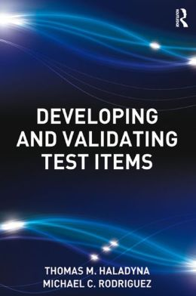

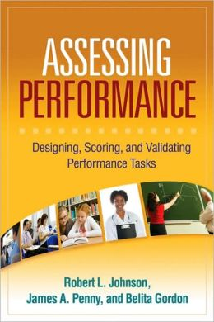
Books

Slide 7

How to do the assignments?

Slide 8
Assignment 1
ASSIGNMENT 1 (10 marks) FRIDAY 7TH FEBRUARY (1000 WORDS)
Select an assessment/ assessment scheme scheme/product/system in your area or discipline-
Develop a framework and criteria for your critique
Critique the (1) assessment purpose and scheme, (2) the items or tasks, (3) the implementation and administration, and (4) the reporting and use of data using key principles derived from classes 1-3.

Slide 9
Assignment 2
ASSIGNMENT 2 (20 marks)- FRIDAY 3RD MARCH (10-12 PAGES)
Select a single topic and/or big idea
Develop a set of specifications to guide the development of a parallel set of selected response (20) constructed response items (1), and performance task (1)
Administer the test/assessment
Score the test/assessment
Report on the test/assessment

Slide 10
Assignment 3
ASSIGNMENT 2- (10 marks) FRIDAY 21ST MARCH
CHOOSE AN ASSESSMENT ISSUE IN YOUR AREA-SBA, CVQ, CAC, NT etc.
In a 15 minute oral presentation, IDENTIFY THE MAJOR CHALLENGES AND MAKE RECOMMENDATIONS that are based on current assessment theory

Slide 11
ISSUES IN ASSESSMENT (3 WEEKS)
High stakes and washback from public examinations and accountability tests
The quality of Teacher Judgment in SBA and CAC-Fostering Assessment Literacy
The student in role assessment- Formative Assessment role in fostering autonomy
Multiple Purposes of Assessments in Assessment Systems-Certification, Accountability, & Learning

Slide 12
CURRENT ASSESSMENT TRENDS
Focus on assessment systems
Increasing significance of formative assessment and assessment as learning
Increased role for performance and authentic assessments
Qualitative-evaluative scales-Rubrics
Multi-use assessments (Continuous & School Based Assessments)
Computer based and Computer Adaptive Testing
Evidence centered design for assessments

Slide 13
Changes in classroom assessment & teaching-learning

Slide 14
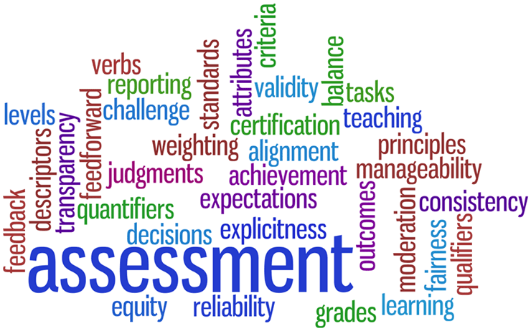
DEFINITIONS

Slide 15
Comparing Measurement with Student Assessment
MEASUREMENT
STUDENT ASSESSMENT
the process by which attributes or dimensions of some element is determined and the target qualities or behaviours are transformed into categories or numbers
the process of observing learning; describing, collecting, recording, scoring, and interpreting information about a student's learning.

Slide 16
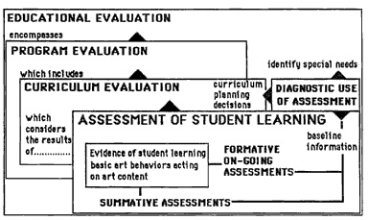
How is assessment different to evaluation and measurement?

Slide 17
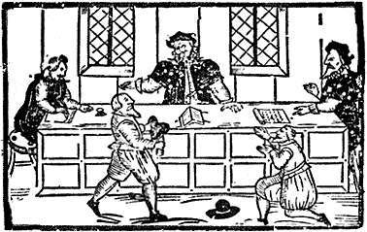
What is Educational Assessment?
The Latin root assidere means to sit beside (as someone assisting a judge to gather and document evidence in a court of law).

Slide 18
What is educational assessment?
Educational assessment is about evidence and inference.
In all cases it involves collecting evidence of student learning. That evidence may be used to make a judgment for different purposes.
Assessment may be formal or informal and include processes such as observing learning; describing, collecting, recording, scoring, and interpreting information on student learning.

Slide 19
What is educational assessment?
Since the evidence may be used for different purposes assessment has different forms.
It is sometimes considered as an episode in the learning process; part of reflection and autobiographical understanding of progress or data may be used to determine placement, promotion, graduation, or retention.

Slide 20
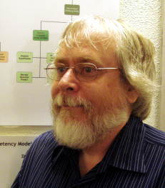

Defining Assessment from an “Evidence Based Design Perspective” -Robert J. Mislevy, Linda S. Steinberg, & Russell G. Almond

Slide 21
A working definition of assessment
TTASCD
An assessment is a machine for reasoning about what students know, can do, or have accomplished, based on a handful of things they say, do, or make in particular settings.

Slide 22
A working definition of assessment
An assessment is more than this, of course. All assessments are embedded in a cultural setting and address social purposes both stated and implicit.

Slide 23
A working definition of assessment
Assessments communicate values, standards, and expectations. Some assessments are opportunities to extend learning. Others don’t even look like assessments as we usually think of them; they look like conversations between a student and a teacher or between two students.

Slide 24

Assessments communicate values, standards, and expectations
A handful of things students say, do, or make in particular settings
Reasoning about what students know, can do, or have accomplished
embedded in a cultural setting and address social purposes both stated and implicit

Slide 25
Mislevy, R. J., Steinberg, L. S., & Almond, R. G. (2003). On the structure of educational assessments. Measurement: Interdisciplinary Research and Perspectives, 1, 3–67.
An assessment is a machine for reasoning about what students know, can do, or have accomplished, based on a handful of things they say, do, or make in particular settings. An assessment is more than this, of course. All assessments are embedded in a cultural setting, and address social purposes both stated and implicit. Assessments communicate values, standards, and expectations. Some assessments are opportunities to extend learning. Others don’t even look like assessments as we usually think of them; they look like conversations between a student and a teacher, or one student with another. What all assessments share, though, is reasoning that relates the particular things students say or do, to what they know or can do as more broadly conceived; that is, in terms that have meanings beyond the specifics of the immediate observations. The argument behind such reasoning is grounded in beliefs about the nature of knowledge in the domain in question, how we recognize it when we see it, and situations in which evidence about that knowledge might be manifest.

Slide 26
A mature and expanded view of student assessment
Assessment is more than making judgements based on test scores. Information is carried or assumed about context and history of the test taker with the situation.
Several inferences are made and assumptions that begin with the test design process- Is the content/skill being measured truly important? To whom? Is the sample of items/tasks truly representative of the domain? Does the task or item really elicit the behaviour inferred? Is the evidence sufficient for making the final judgement?

Slide 27
What we learn from the definition
Assessments are always a sample of the domain universe
Assessments reflect what is valued by the culture
We must extrapolate to the real domain universe
The meanings we attach to the performance relate to this extrapolation
Assessments are therefore fallible
We can make assessments better by focusing upon evidence-centred design

Slide 28
A focus on assessment systems
An assessment system is a group of policies, structures, practices, and tools for generating and using information on student learning and achievement.
Marguerite Clarke, World Bank, 2012

Slide 29
AN EMERGING FOCUS ON ASSESSMENT SYSTEMS
Effective assessment systems are those that provide information of sufficient quality and quantity to meet stakeholder information and decision-making needs in support of improved education quality and student learning outcomes.
Marguerite Clarke, World Bank, 2012

Slide 30
A VARIETY OF ASSESSMENTS
TYPES | PURPOSES | ROLES | FORMATS
PUBLIC EXAMINATIONS | CERTIFY AND SELECT | SUMMATIVE AND ASSESSMENT OF LEARNING | CONSTRUCTED RESPONSE
NATIONAL LEARNING ASSESSMENTS | MONITOR AND HOLD ACCOUNTABLE |  | SELECTED RESPONSE
INTERNATIONAL ASSESSMENTS | MONITOR |  | PERFORMANCE ASSESSMENT
CLASSROOM ASSESSMENT | PROMOTE STUDENT LEARNING | FORMATIVE & ASSESSMENT FOR LEARNING
SBA | MULTIPURPOSE

Slide 31
MATCHING TYPES & PURPOSES
CLASSROOM ASSESSMENT
CLASSROOM ASSESSMENT
To promote & measure
Student Learning
To promote Student Learning
NATIONAL ASSESSMENTS
NATIONAL ASSESSMENTS
To measure institutional & system quality
To measure institutional & System quality
PUBLIC EXAMINATIONS
PUBLIC EXAMINATIONS
To select & certify
To select & certify
INTERNATIONAL ASSESSMENTS
INTERNATIONAL ASSESSMENTS
To measure and compare system
quality across nations
To measure and compare system quality

Slide 32
Definitions
Public examinations are high-stakes assessments used for selection, certification, or qualification. (traditionally at 11+, 16+, & 18+).
Classroom assessment includes all the assessment and measurement strategies (formative & Summative (Assessment of, as and for learning) used by the teacher within the classroom.
National assessments are large scale assessments used for monitoring a nation al system or parts of that system.
International assessments are large scale assessments used for comparing performance across several nation systems or within a region.

Slide 33

Public Examinations
These are large scale assessments (operating externally of the school but sometimes including school based components) and designed mainly to select or certify students (11+, CSEC, & CAPE)

Slide 34
Large Scale Assessment
These are assessments that are standardized and administered by the administrative centre and used for accountability or certification (includes public examinations and national assessments of educational achievement).
This type of assessment may be compared with classroom assessments, and different rules may apply to some technical issues like validity and usability.

Slide 35
National assessments of educational achievement
These are assessments designed for monitoring achievement standards in the entire system or parts of the system.
Other terms are “learning assessments,” National tests” or “national assessments of educational achievements” [preferred] (Example-NCSE)

Slide 36

International Assessments
These are standardized measures administered across a number of nations designed to provide comparative data and benchmarks across different countries and education systems-
Example Programme for International Student Assessment (PISA)-15+)

Slide 37
The Architecture of Caribbean Assessment System
PUBLIC EXAMINATIONS
NATIONAL ASSESSMENTS
INTERNATIONAL ASSESSMENTS
Classroom Assessment

Slide 38


Slide 39
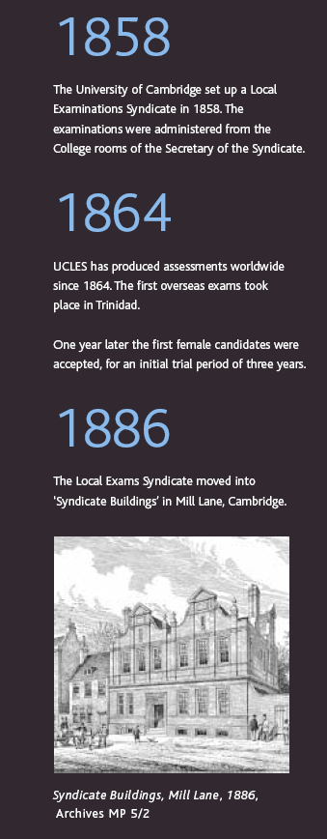

Slide 40
1864- Cambridge O Levels
1961- Common Entrance Examination
Greater emphasis on multimodal assessment and critical thinking
1979- CXC O Levels
1985- Writing component introduced into 11+
Literacy focus and CRs used
2003- CEE to SEA (Components reduced)
2004- CAPE implemented nationally
Tensions between international and national examination bodies
Public Examinations Timeline in Trinidad and Tobago

Slide 41
Some Common Issues in Public Examination Systems
Fairness/Bias/Construct-Irrelevant Variance/ Validity
Consequences/Impact
Portability of Qualifications/ Globalization
Standards/Grades/Marking/Moderation
Legitimacy/ Transparency
Equivalence/Comparability
Reliability/Raters/Rating
Overload/Timing/Emphasis
Academic Cheating

Slide 42

Roles

Slide 43
On classroom assessment and roles
Assessment in the classroom may be
formative (used to promote learning)
diagnostic (used to remediate)
summative (used to measure student learning).

Slide 44
Definitions
Formative Assessment is
A process in which data is collected on the degree to which students know or are able to do a given learning task, and which identifies the part of the task that the student does not know or is unable to do. Feedback as a part of the process is used to suggest future steps for teaching and learning.

Slide 45
Definitions
Summative Assessment
Is the process of making a judgment of student learning at the conclusion of a unit or units of instruction, or an activity or plan to determine student skills and knowledge, or the effectiveness of a plan, or an activity.

Slide 46
On classroom assessment
TTASCD
The critical distinction between assessment “for” and “of” learning is the basis of much recent theory and research, with the emergence of assessment for learning (also called embedded assessment and assessment to promote learning) as the key lynch pin in reforming teaching, learning and assessment.

Slide 47

Formats

Slide 48
Assessment formats
There are three assessment formats:
Assessment Format Examples
Selected Response MCQs
Constructed Response SAQs, Essays
Performance Assessments Portfolios, Projects

Slide 49
Definitions
SELECTED RESPONSE ITEM/TASK- An exercise for which examinees must choose a response from an enumerated set (e.g. multiple choice or matching) rather than create their own responses or products (as in performance assessment).
CONSTRUCTED RESPONSE ITEM/TASK- An exercise for which examinees must create their own responses or products (performance assessment) rather than choose a response from an enumerated set (multiple choice).

Slide 50
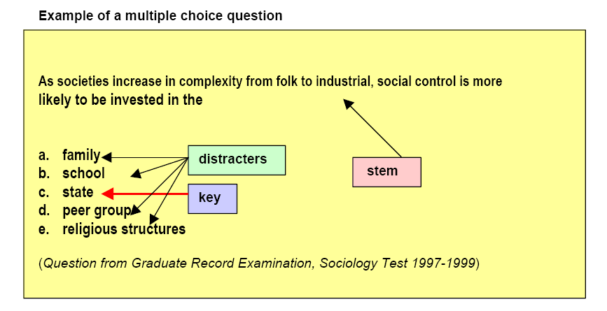
Sample Assessment Modes- Selected Response

Slide 51
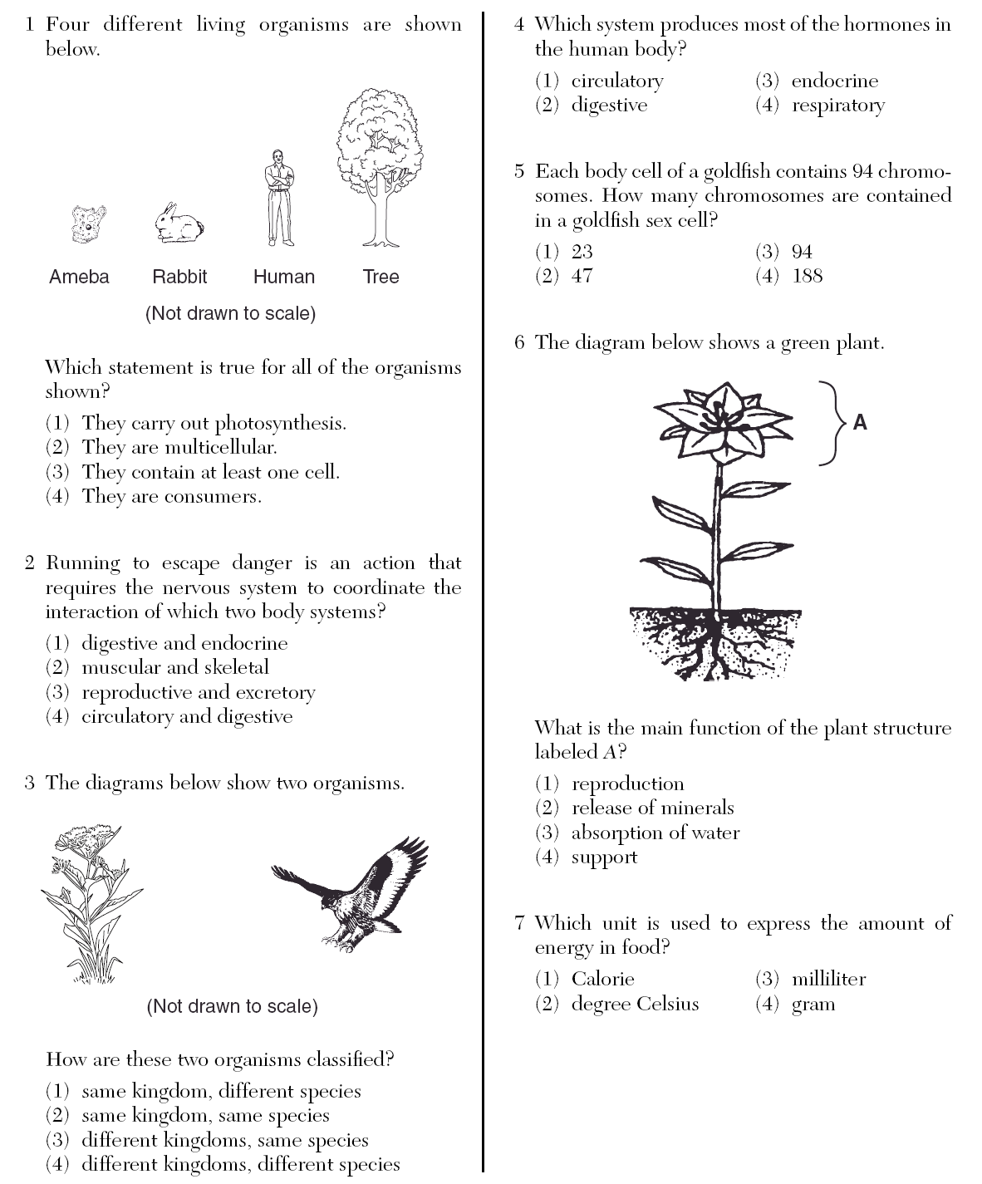

Slide 52
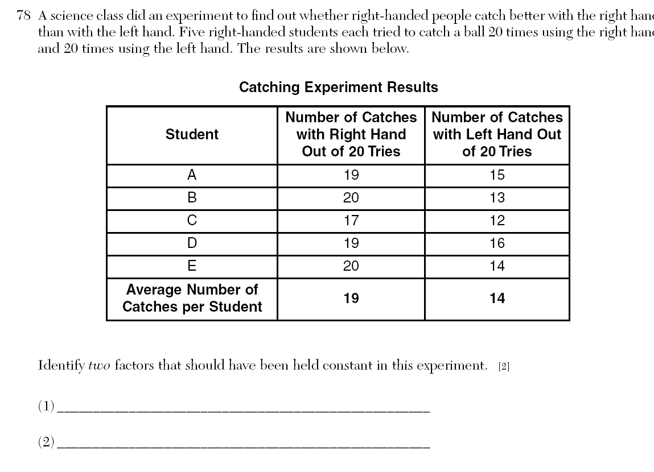

Slide 53
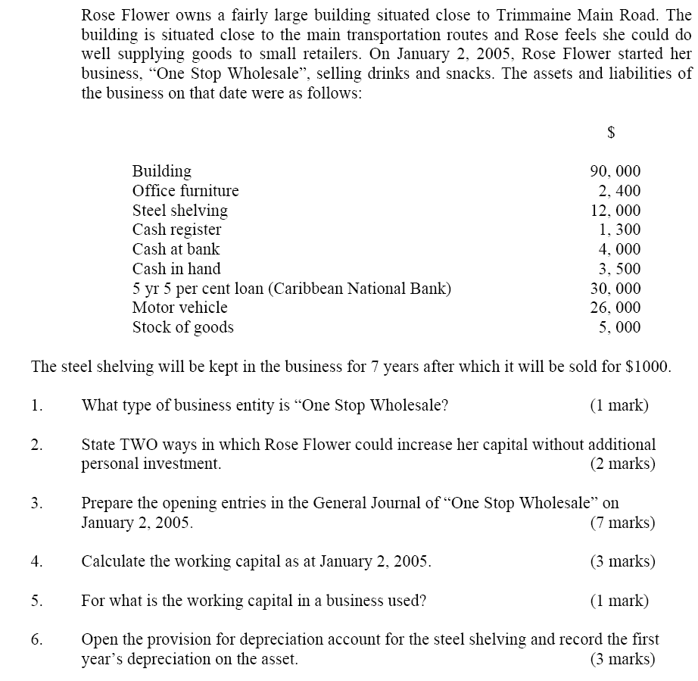
Sample Assessment Modes- Constructed Response

Slide 54
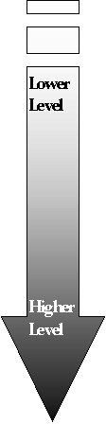
Why are different keywords used in the essay prompts?
Classification of Common Key Words Used in Prompts
Define
Name
State
List
Enumerate
Discuss
Apply
Organize
Interpret
Examine
Contrast
Differentiate
Appraise
Predict
Suggest
Develop

Slide 55
Definitions
A performance assessment is a task in which the student's active generation of a response is observable either directly or indirectly via a permanent product.
The task might be authentic in the sense that the nature and context in which the assessment occurs is relevant and represents "real world" problems or issues.

Slide 56
Sample Assessment Modes- Performance Assessments

Slide 57
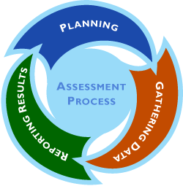
What is the assessment cycle?
The Assessment Cycle
Design
Development
Administration
Scoring
Test score use & interpretation

Slide 58
TEST DEVELOPMENT Processes
Overall Plan
Content Definition
Test Specifications
Item Development
Test Design & Assembly
Test Production
Test Administration
Scoring Test Responses
Standard Setting
Score Reporting
Item Banking
Writing Technical Report

Slide 59
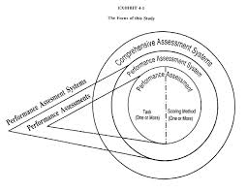
Assessment Systems & Schemes

Slide 60
Some Basic Assessment Principles
TTASCD
Assessment must be aligned to and integrated with the curriculum and with the teaching-learning philosophy.
Assessment should be multi-modal.
We should strive towards a comprehensive balanced assessment system, with appropriate use of assessment of, for, and as learning.
Assessment must be “high inference” and demanding.
The scoring of assessments must be rigorous, standardized, and defensible.

Slide 61
More Assessment Principles
Assessment systems must be managed effectively, with quality assurance mechanisms in place.
We should avoid assessment overload. Attention must be paid to the timing and frequency of assessments.
Professional development should include a focus on assessment literacy for teachers.
Heads should demonstrate leadership in the area of assessment.

Slide 62
Assessment must be aligned
Assessment is neither an add-on or an independent component, but should be integrated with other components.
If the assessment system is not aligned with the other major components, it can create a hidden curriculum or washback.

Slide 63
Assessment must be aligned
If the assessment system is not aligned with the other major components, it can create a hidden curriculum.
Curriculum
Teaching-Learning
Assessment

Slide 64
On alignment
Systems which overemphasize and mimic high stakes assessments in the classroom are likely to be misaligned.
The focus on public examinations has impacted on the use of classroom assessment, standardized diagnostic tests, and national learning assessments.

Slide 65
Aspects of alignment
Content of curriculum (Curriculum Coverage)
Use both MCs and CRs to cover curriculum along with Table of Specifications
Level of objectives-Higher order thinking
Explicitly construct questions that test application and higher order skills
Philosophy of teaching and learning-Constructivism, activity oriented
Include open-ended performance assessments

Slide 66
From System Principles to Departmental Plan
Philosophy & Policy Statements
Structures & Leadership
Training (Professional Development)
Emphases
Annual Assessment Cycle

Slide 67
From plan to whole school policy
A whole school policy on assessment & reporting is an agreed approach to assessment practice and reporting that reflects high quality standards.
Collaboratively developed from the plans of each department

Slide 68
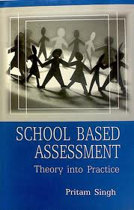
Multipurpose Assessments

Slide 69
Tensions in SBA
SBA Activity has both summative and formative functions.
In formative, we are trying to help the student learn by providing feedback.
In summative, we are assigning them a grade or a mark as a judgment of performance
The teacher must reconcile his role as “assessor” and “judge”

Slide 70

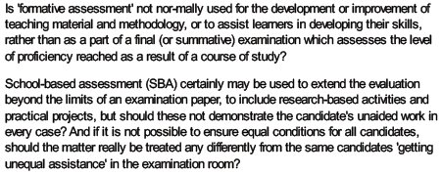
Reconciling the Tensions

Slide 71
Assessments of, as, and for learning
Assessment FOR learning are formative & diagnostic assessments. Assessment FOR learning is the use of a task or an activity for determining student progress during a unit or block of instruction. Teachers are can adjust classroom instruction based upon the needs of the students and students are provided with valuable feedback on their own learning. Assessment OF learning is the use of a task or an activity to measure, record and report on a student's level of achievement in regards to specific learning expectations. These are often known as summative assessments. Assessment AS learning is the use of a task or an activity to allow students the opportunity to use assessment to further their own learning. Self and peer assessments allow students to reflect on their own learning and identify areas of strength and need. These tasks offer students the chance to set their own personal goals and advocate for their own learning.

Slide 72
Assessment of Learning- Is that what we are doing?
‘Assessment for Learning’ and ‘formative assessment’ are phrases that are widely used in educational discourse in the United States, Canada, New Zealand, Australia, the United Kingdom and Europe. A number of definitions, some originally generated by members of this Conference, are often referred to. However, the ways in which the words are interpreted and made manifest in educational policy and practice often reveal misunderstanding of the principles, and distortion of the practices, that the original ideals sought to promote. Some of these misunderstandings and challenges derive from residual ambiguity in the definitions.
Position Paper on Assessment for Learning from the Third International Conference on Assessment for Learning Dunedin, New Zealand, March 2009

Slide 73
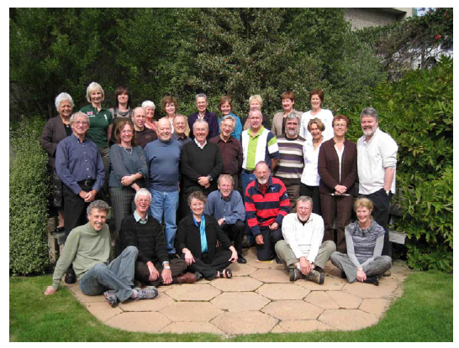
The participants pictured in this photograph taken on the last day of the conference are (left to right from back to front):Sandie Aitkin, New Zealand; Mary James, England; Mien Seger, Netherlands; Lorna Earl,Canada; Susan Brookhart, United States; Menucha Birenbaum, Israel; Carolyn Hutchison,Scotland; Ruth Sutton, England; Claire Wyatt-Smith, Australia; Alison Gilmore, NewZealand; Lester Flockhart, New Zealand; Mary Chamberlain, New Zealand; Filip Dochy, Belgium/Netherlands; Jim Popham, United States; Royce Sadler, Australia; Frank Philips,United States; Dany Laveault, Canada; Geoff Cainen, Canada; Richard Daugherty, Wales;Val Klenowski,; Australia; Ann Longston, Canada; Jeffrey Smith, New Zealand; PeterJohnston, United States; Terry Crooks, New Zealand; Anne Davies, Canada; Gordon Stobart,England; Ken O’Connor, Canada; Rick Stiggins, United States; Kari Smith, Norway. Teammembers not in photograph: Linda Allal, Switzerland; Linda Darling Hammond, UnitedStates; John Hattie, New Zealand; Juliette Mendelovits, Australia; Lisa Smith, New Zealand

Slide 74
Box 3: Four working definitions of formative assessment endorsed by the 2009 position paper on assessment for learning.
1. ‘Assessment for Learning is the process of seeking and interpreting evidence for use by learners and their teachers to decide where the learners are in their learning, where they need to go and how best to get there’. Assessment Reform Group (2002)
2. ‘Practice in a classroom is formative to the extent that evidence about student achievement is elicited, interpreted, and used by teachers, learners, or their peers, to make decisions about the next steps in instruction that are likely to be better, or better founded, than the decisions they would have taken in the absence of the evidence that was elicited’. Black & Wiliam (2009).
3. ‘Formative assessment is a process used by teachers and students during instruction that provides feedback to adjust ongoing teaching and learning to improve students’ achievement of intended instructional outcomes.’ McManus (2008).
4. ‘Formative assessment is a planned process in which assessment-elicited evidence of students’ status is used by teachers to adjust their ongoing instructional procedures or by students to adjust their current learning tactics.’ Popham (2008).

