Slide 1
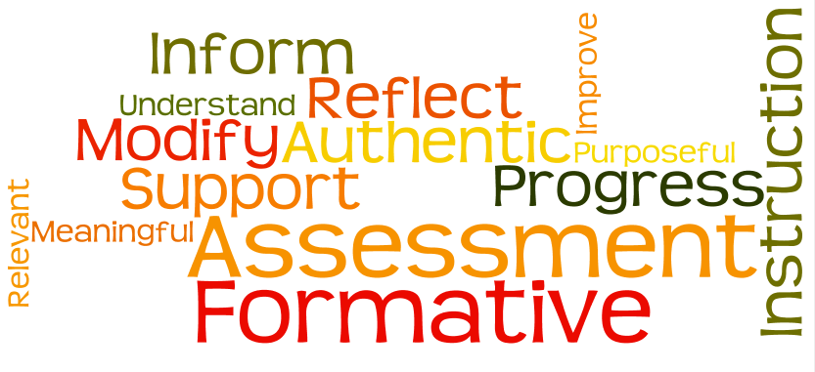
Comprehensive Models of Formative Assessment

Slide 2
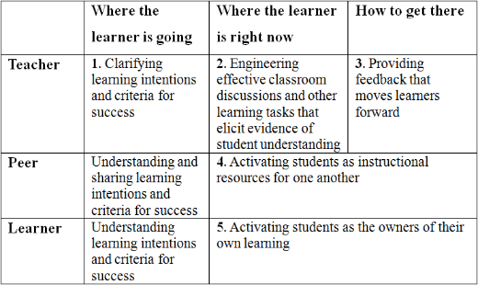
A theory of formative assessment

Slide 4
7 Step Model
Where am I Going?
1. Provide students with a clear and understandable vision of the learning target.
2. Use examples and models of strong and weak work.
Where am I Now?
3. Offer regular descriptive feedback.
4. Teach students to self assess and set goals.
How Can I Close the Gap?
5. Design lessons to focus on one learning target or aspect of quality at a time.
6. Teach students focused revision.
7. Engage students in self-reflection and let them keep track of and share their learning.

Slide 5
Tuttle (2009)
Pre-assessing students
Sharing learning goals with students
Sharing or co-creating of learning criteria with students
Employing quality classroom discourse and questioning
Using rich and challenging tasks that elicit students’ responses
Identifying the gap between where the students are now and the desired standard goal
Providing feedback that helps students identify how to improve
Using self-assessment and peer assessment
Providing students with opportunities to close the gap between current and desired performance
Celebrating learning progressions

Slide 6
What are Learning Progressions
Learning progressions
  describe in words and examples what it means to move over time toward more expert understanding of some big idea or topic.
  depict successively more sophisticated ways of thinking about an idea that might reasonably follow one another as students learn.
  have been referred to by many different names, including progress variables, learning trajectories, progressions of developmental competence, and profile strands.

Slide 7
Learning Progressions inform Assessment
Learning progressions inform assessment in the following cycle
  Translate the big ideas assessment tasks or activities suitable for classroom settings through which students can demonstrate their understanding of big ideas and practices.
  Use student performances to develop clusters of assessment tasks or items, including both traditional and nontraditional items.
  Use rning as a basis for rubrics to interpret student responses, explaining how responses reveal students’ thinking with respect to big ideas and learning progressions.

Slide 8
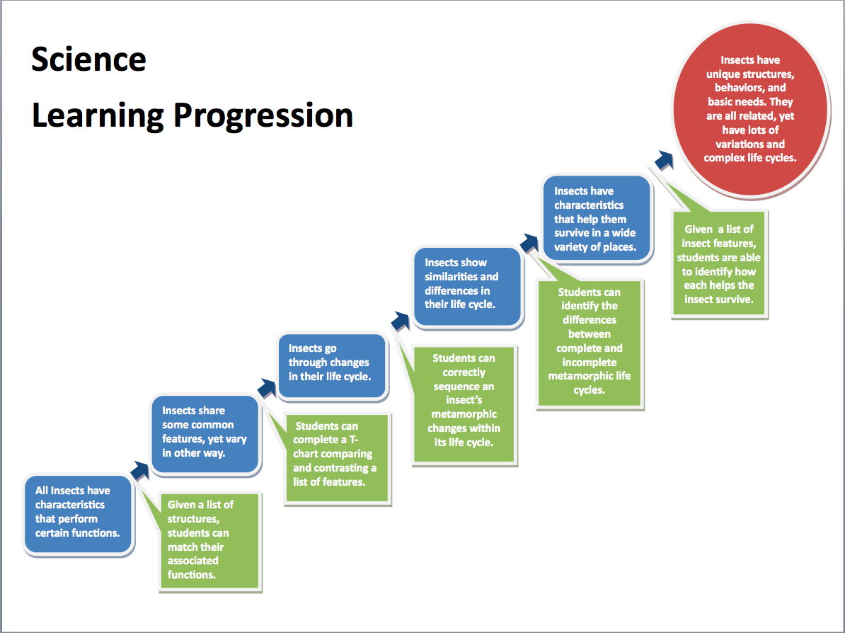

Slide 9
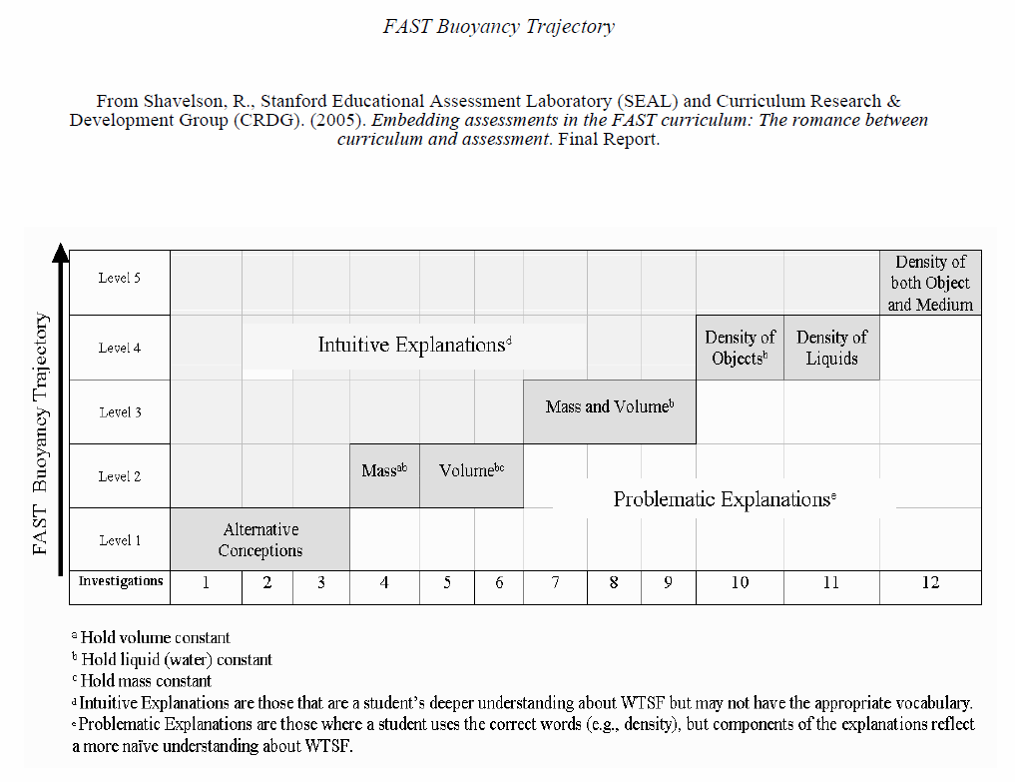

Slide 10
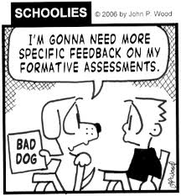

Slide 11
Formative Feedback
Don’t leave it open-ended or ambiguous. Give clear indications of the criteria that have been used to assess the quality of the product a student submits
Don’t wander from the point. Base all feedback on criteria specified for the assignment.
Don’t delay. Provide feedback as soon as possible after the student submits the assignment.

Slide 12
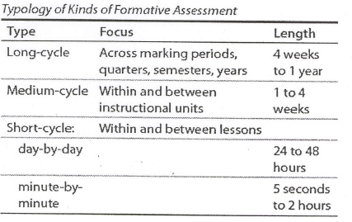

Slide 13
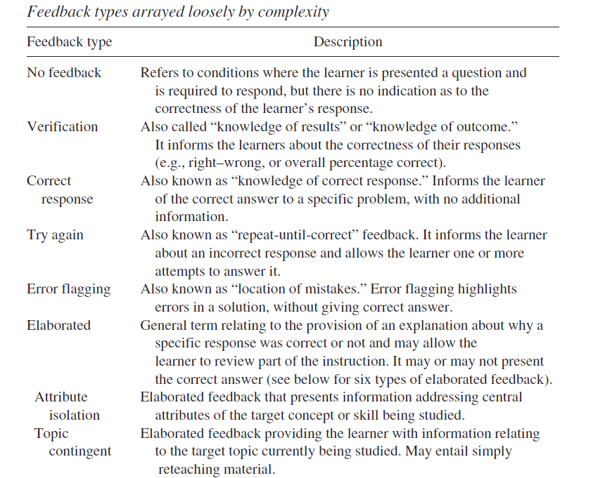

Slide 14
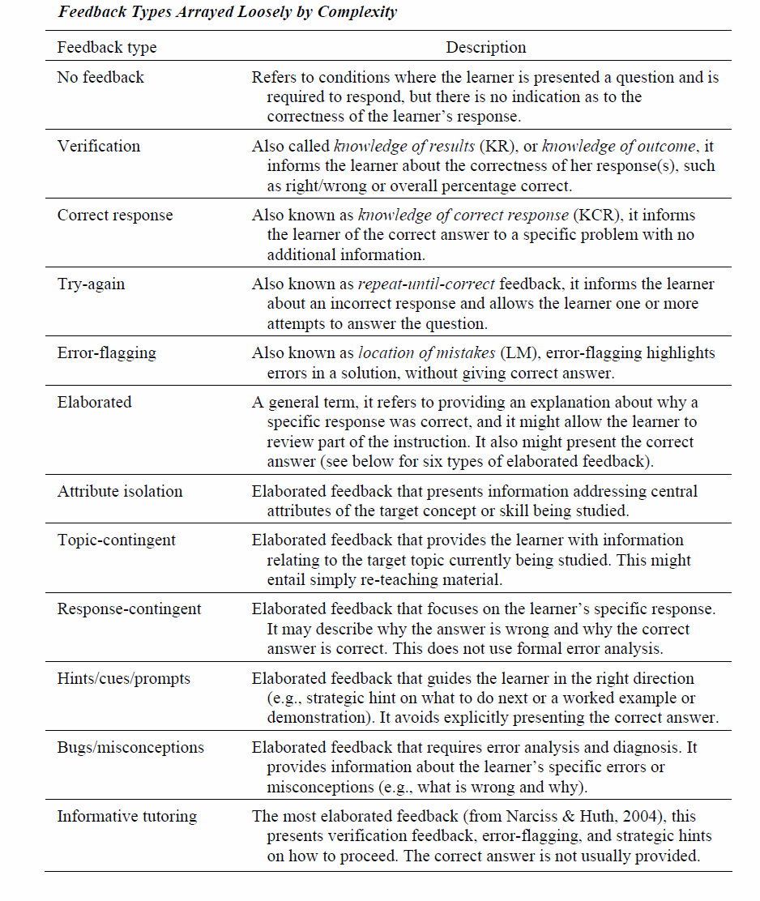

Slide 15
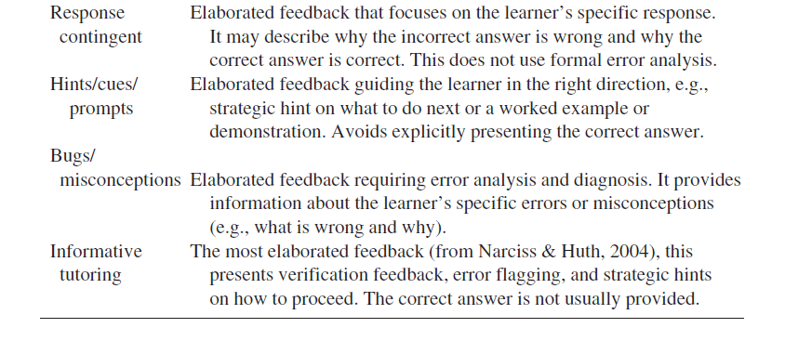

Slide 16
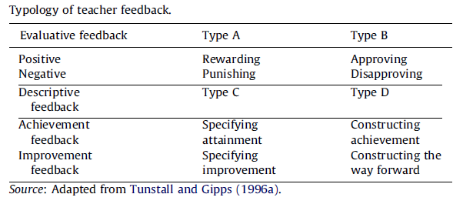
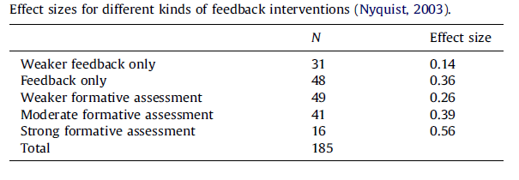

Slide 17
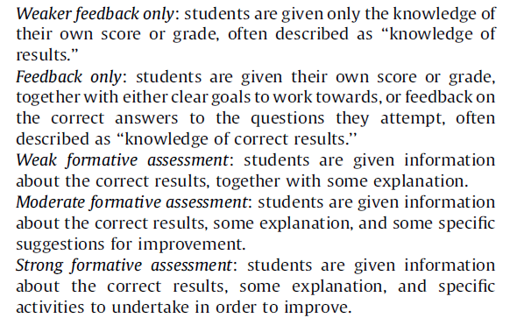
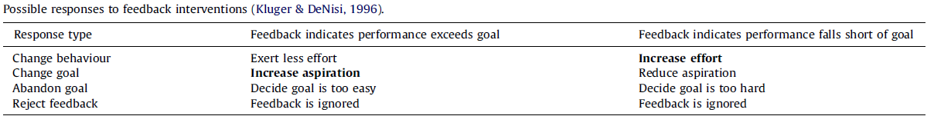

Slide 18
The scoring of assessments
Defensible means that there are legitimate reasons for giving a mark and the system can stand up to scrutiny.
Rigorous means that the system is reliable and iterative
Standardized means that there is low inter-rater reliability

Slide 19
The scoring of assessments
This might not be a problem in scoring MCs, but CRs and Open-Ended PAs can prove a problem.
The most popular solution is the Rubric.

Slide 20
The scoring of assessments-Rubrics
A scoring rubric is a set of ordered categories to which a given piece of work can be compared.
Scoring rubrics specify the qualities or processes that must be exhibited in order for a performance to be assigned a particular evaluative rating.

Slide 21
Parts of a Rubric
A scale of points representing a continuum of quality.
Descriptors containing standards and criteria to judge the performance of the work.
Criteria for the conditions associated with successful performance.
Standards for describing how well criteria must be met

Slide 22
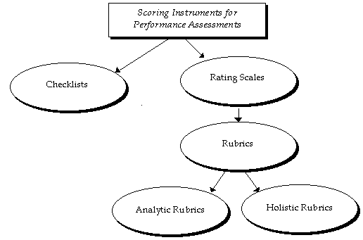
From checklist to rubric

Slide 23
Types of Rubrics

Slide 29
Developing a Rubric
Identify the type and purpose of the Rubric
Identify Distinct Criteria to be evaluated
Determine your levels of assessment
Describe each level for each of the criteria, clearly differentiating between them –
Involve learners in development and effective use of the Rubric
Pre-test and retest your rubric

Slide 30
Developing a Rubric
Identify the type and purpose of the Rubric - Consider what you want to apply assess/evaluate and why.
Identify Distinct Criteria to be evaluated - Develop/reference the existing description of the course/assignment/activity and pull your criteria directly from your objectives/expectations. Make sure that the distinction between the assessment criteria are clear.

Slide 31
Developing a Rubric
Determine your levels of assessment - Identify your range and scoring scales. Are they linked to simple numeric base scores? Percentages? Grades?
Describe each level for each of the criteria, clearly differentiating between them - For each criteria, differentiate clearly between the levels of expectation. Whether holistically or specifically, there should be no question as to where a product/performance would fall along the continuum of levels.

Slide 32
Developing a Rubric
Involve learners in development and effective use of the Rubric - Learner engagement in the initial design and development will help to increase their knowledge of expectations and make them explicitly aware of what and how they are learning and their responsibility in the learning process.

Slide 33
Developing a Rubric
Pre-test and retest your rubric - A valid and reliable rubric is generally developed over time. Each use with a new group of learners or a colleague provides an opportunity to tweak and enhance it.

