Slide 1
EDME 6121 2014
(ED61U)
Evaluation of Educational Systems
(4 credits)
Jerome De Lisle

Slide 2
Rationale
This course is intended to assist educational researchers who wish to become evaluators in defining what their responsibilities are in judging programmes, products and climates, and policies.
The course is for beginners and focuses on basic competencies in evaluation only. More advanced work in measurement, research and evaluation is necessary to qualify as an effective evaluator.

Slide 3
Rationale
The course will assist novice evaluators to (1) understand the process of evaluation, (2) provide an evaluation framework, including an appropriate model or strategy to guide an evaluation; and, (3) makes available the methods and techniques for dealing with the collection and analysis of evaluation data.

Slide 4
Objectives
Objectives –
Students will –
  1. understand the scope of their involvement in the evaluation of courses, programmes, and curricula at the school
  2. discriminate between standards used to judge or evaluate performance in different programmes or contexts
  3.design and use appropriate models, strategies or frameworks to conduct evaluation exercises
  4. select outcome measures in evaluating teachers, administrators, students, and departments and projects at the school
  5. identify relevant approaches and strategies in data collection and data analysis

Slide 5
Listed Content in Handbook
Perspectives
  role and context of evaluation, evaluation as a disciplined inquiry, standards for evaluation of programmes, products and curricula;
Focus on evaluation within an educational system
  system-wide evaluation, national monitoring of existing curricular programmes, teacher evaluation and accountability, school evaluation – administration, curricular programme, plant, equipment and materials; evaluation of performance units;
Design evaluation/Programme Evaluation
  models and strategies:
  Selection of outcome measures, judgmental, decision-management and decision –objective strategies, standard group designs, individualized programme designs, multi-stage, holistic and quality assurance models.-2010
Evaluation of curriculum development projects
  from the identification of values and derivation of aims to large-scale implementation;

Slide 6
2012-2013 Reorganization of Content
National Systems of Evaluation in Education
Programme Evaluation-Essentials of,
Evaluation Models & Designs
  Theories and Theorists Added

Slide 7
2014 Content
PART 1-National Evaluation Systems in Education
  Judging the Quality of Education Systems
  Trends in Monitoring Learning within National Education Systems
  Making Best Use of National & International Assessments of Educational Achievement (Emphasis on PISA 2010-2011 & PIRLS 2011)
  Benchmarking using International Assessments (Emphasis-2011, 2012, 2013)

Slide 8
2014 Content
PART 2-Programme Evaluation-Essentials
  Logic Modelling (Emphasis 2009-2013)
  Discrete Steps in Evaluating Education Programmes in Schools & Systems
  The Role of Evaluation in the Effective Management of Programmes
  (New Working Example 2011-13-An Evaluation Design for Judging the Value of Nutrition Programmes in High Poverty Schools)

Slide 9
2014 Content
PART 3-Evaluation Models & Designs
  Evaluation Philosophy, Approaches & Strategies
  Evaluation Model Defined
  Selecting Appropriate Designs
  (2012 Emphases-Theory Driven Design by Chen and Donaldson/ Stakeholder Approaches/ Utilization Focused & Developmental Evaluation )
  Quantitative Approaches (Emphasis 2011/2012- RCTs, Quasi-Experimental and Experimental Designs), Qualitative, & Mixed Methods Designs)
  - Evaluation Theory & Theorists

Slide 10
Events
AEA (American Evaluation Association) Conference, Washington DC, USA

Slide 11
Part 1-EVAL of ED. SYSTEMS
CLASS 1
  -INTRODUCTION & WELCOME
  -THE CONTEXT OF EVALUATION
CLASS 2
  DEFINITIONS, EVALUATOR COMPETENCIES, AND CHARACTERISTIC OF EVALUATION AS A PROFESSION
CLASS 3
  -EDUCATIONAL INDICATORS & MONITORING STUDENT LEARNING-THE ROLE OF LARGE SCALE ASSESSMENTS

Slide 12
Part 1-EVAL of SYSTEMS
CLASS 4
  NATIONAL SYSTEMS OF EVALUATION-EDUCATIONAL INDICATORS & MONITORING STUDENT LEARNING
CLASS 5
  NATIONAL ASSESSMENTS OF EDUCATIONAL ACHIEVEMENT-PURPOSE AND FUNCTION
CLASS 6
  -REGIONAL AND INTERNATIONAL ASSESSMENTS -GROWTH & IMPACT
CLASS 7
- BENCHMARKING USING IA

Slide 13
Part 2-JDL-PROGRAM EVAL/DESIGN
CLASS 8
  - PROGRAMME EVALUATION–Overview
CLASS 9
  - EVALUATING PROGRAMMES-PROCESS
  Using Logic Models

Slide 14
Part 3-Models & Designs
  CLASS 10
  -Evaluation Models-Use and Variety
CLASS 11
  Evaluation Models-Use and Variety
CLASS 12
  -Exploration of Select Models/Approaches
CLASS 13
  - Evaluation Designs & Credible Evidence
CLASS 14
  -Evaluation Theories & Theorists

Slide 15
Assessment
CLASS 15
  Examination Practice
Examination - 60 %
  Three Questions-from Three Sections in Three Hours
Coursework Assignment - 40%
  For 2014-TWO 10 page papers (15/25)

Slide 16

Sample Past Exam Papers

Slide 17
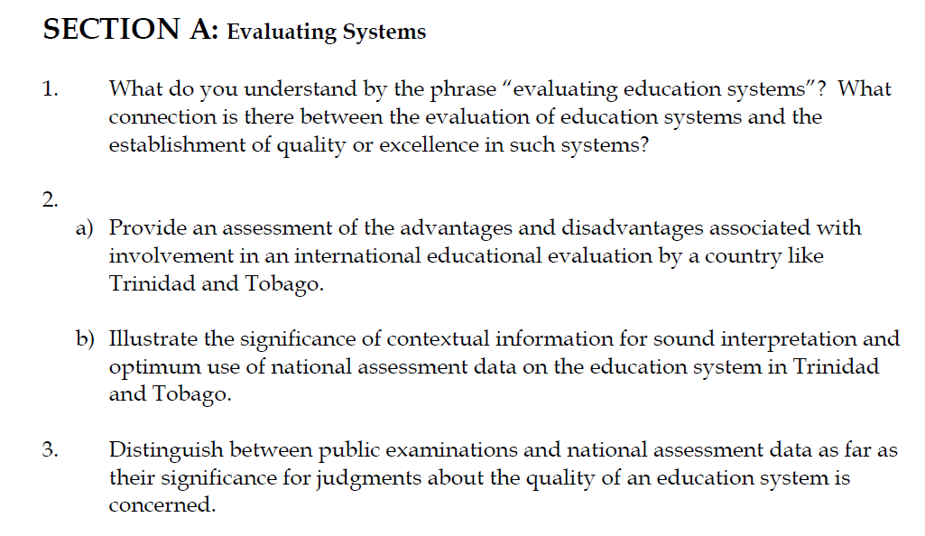

Slide 18
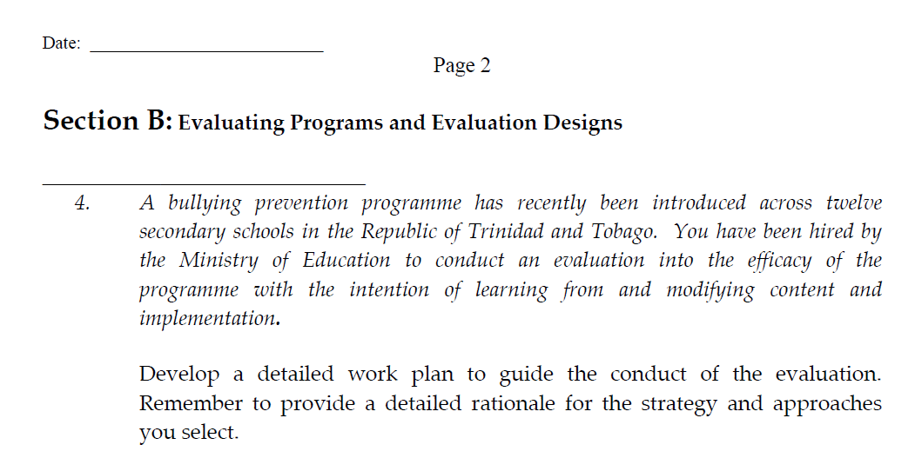

Slide 19
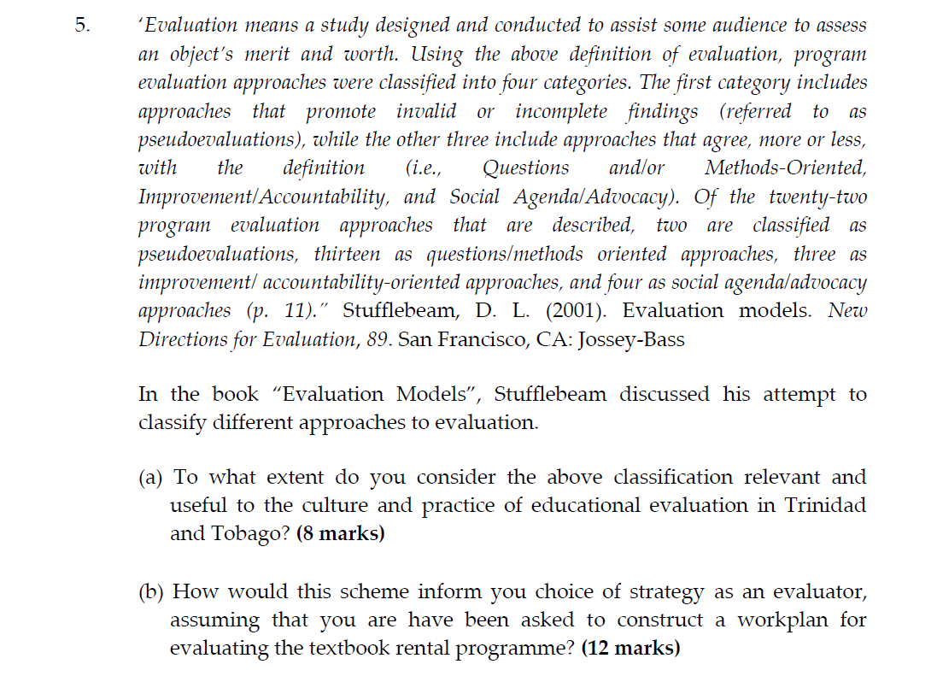

Slide 20
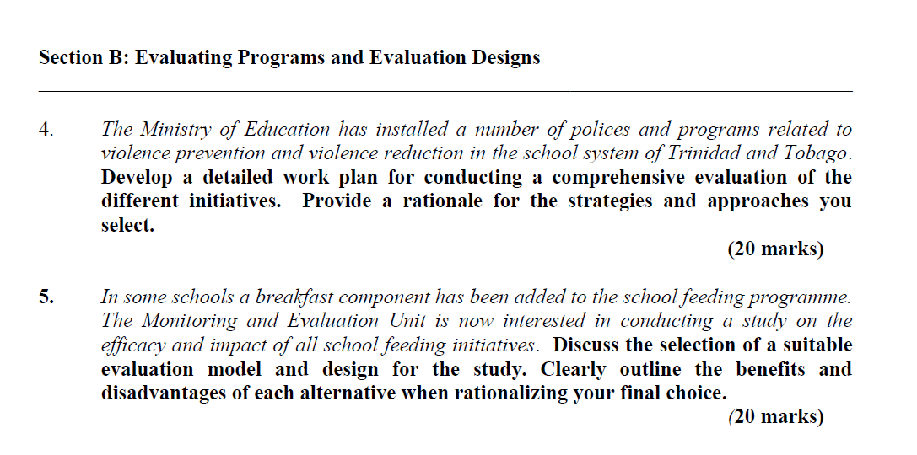

Slide 21
The 2011-2012 redesign

Slide 22


Slide 23
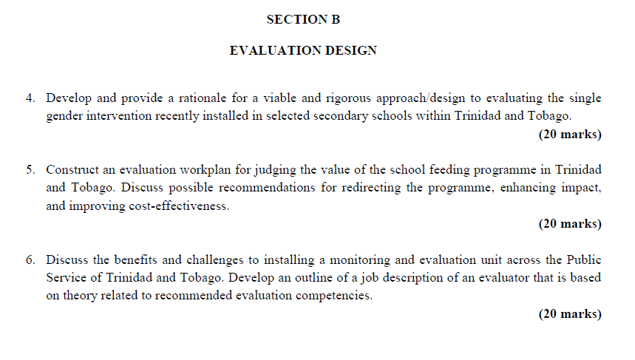

Slide 24
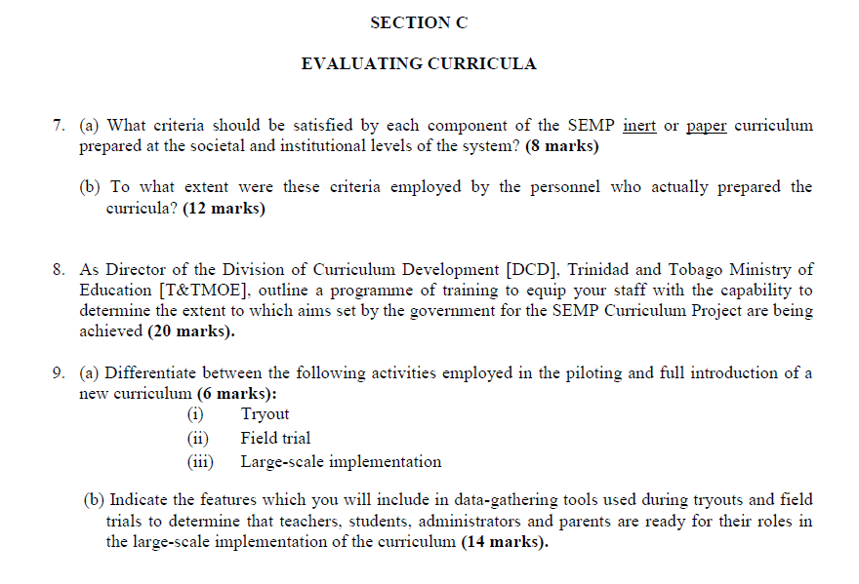

Slide 25
Course Work
Two 10 page (2500 words) assignments
Assignment 1-
  You are manager of the International Assessment Programme in the Ministry of Education, Trinidad and Tobago. Construct a Cabinet Note that provides justification for continuing and expanding the international assessment programme in Trinidad and Tobago.

Slide 26
Assignment 1-Scaffolding
Consider use of international assessments elsewhere (Ravela et al. 2008)
Complete a cost-benefit analysis
Focus on a data generation and use system for evidence-based policy-making (Segone, 2009)
Consider choices of assessment framework
Consider the use and value of results, including comparative studies, evidence-based policymaking, and international benchmarking

Slide 27
Assignment 2
DEVELOP AN OUTLINE OF AN EVALUATION WORKPLAN FOR ANY SCHOOL, CURRICULUM, OR SYSTEM PROGRAMME RECENTLY IMPLEMENTED WITHIN THE EDUCATION SYSTEM OF TRINIDAD & TOBAGO
Scaffolding
  1. Describe the object of the evaluation
    – Extended description of school programme, including purpose, aims, objectives, initiation and implementation, and other relevant contextual factors (Chapter 13-Worthen et al., 1997)
  2. Focus the evaluation
    – Develop Evaluation Questions AND Goals, Criteria, Indicators, Targets, OR Standards (Provide Rationale for each) (Chapter 14 -Worthen et al., 1997)
  3. Suggest & describe an appropriate evaluation design/model.
    Recommend AN APPROACH/MODEL AND A DESIGN
    In the Design, describe the Sample/Sampling strategy, Data Collection Approaches, Instruments, and Data Analysis. (Provide Rationale for Choices) (Chapter 4 & 15 -Worthen et al., 1997)
  4. Identify the likely audience and content of the report.
    Include proposals for use of data (Chapter 19 -Worthen et al., 1997)
    Comment on the politics of evaluation

Slide 28
Non Credit Assignment
Critique a documented evaluation of any local or Caribbean educational programme

Slide 29

Evaluation as a Profession

Slide 30
AEA
Evaluation is a profession composed of persons with varying interests, potentially encompassing but not limited to the evaluation of programs, products, personnel, policy, performance, proposals, technology, research, theory, and even of evaluation itself.

Slide 31
These include but are not limited to the following: bettering products, personnel, programs, organizations, governments, consumers and the public interest; contributing to informed decision making and more enlightened change; precipitating needed change; empowering all stakeholders by collecting data from them and engaging them in the evaluation process; and experiencing the excitement of new insights.

Slide 32
Based on differences in training, experience, and work settings, the profession of evaluation encompasses diverse perceptions about the primary purpose of evaluation.

Slide 33
Despite that diversity, the common ground is that evaluators aspire to construct and provide the best possible information that might bear on the value of whatever is being evaluated. The principles are intended to foster that primary aim.

Slide 34
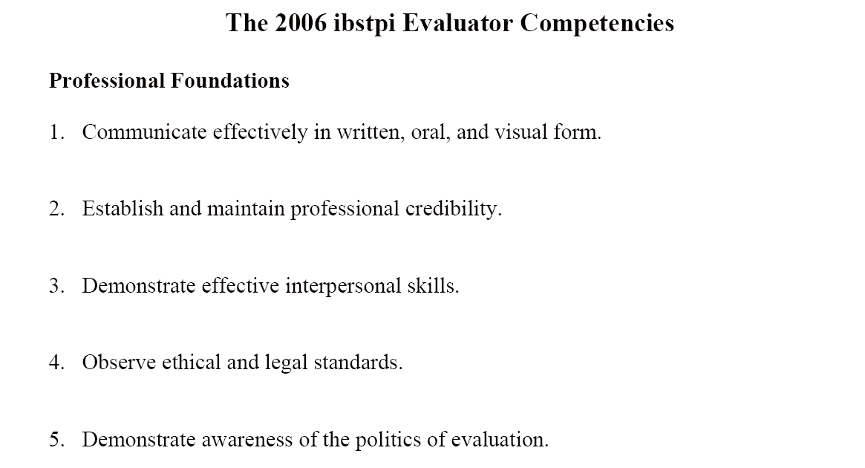
Evaluator Competencies

Slide 35
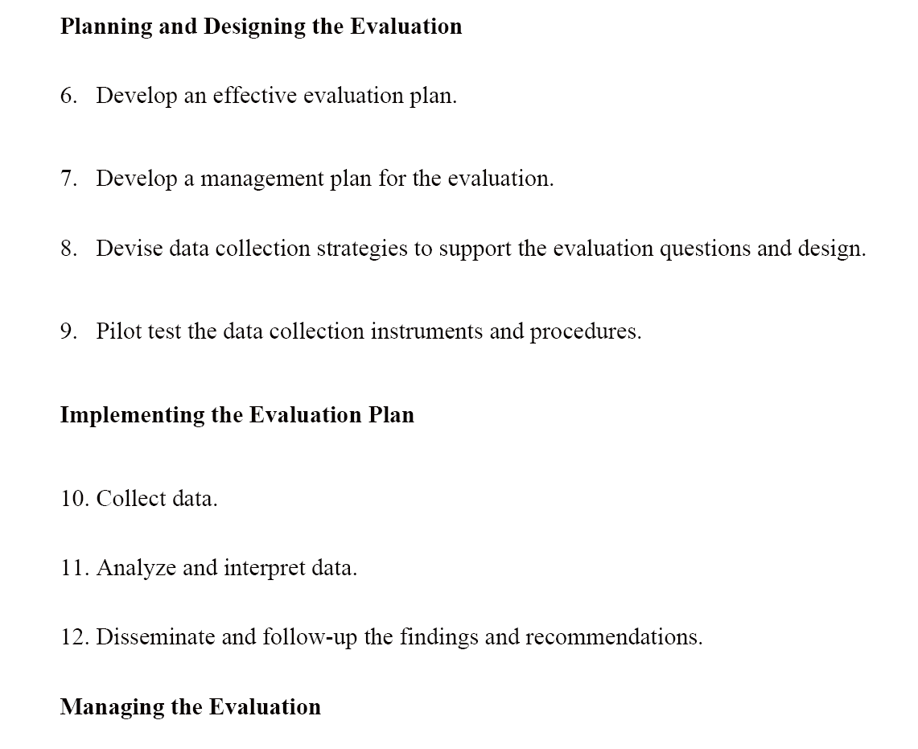
Evaluator Competencies

Slide 36
Evaluation as a Profession
Some consider evaluation to be a quasi-profession rather than a mature profession.
However, there are standards and competencies as well as associations and publications in the area.
Feel free to join the AEA (American Evaluator’s Association)

Slide 37
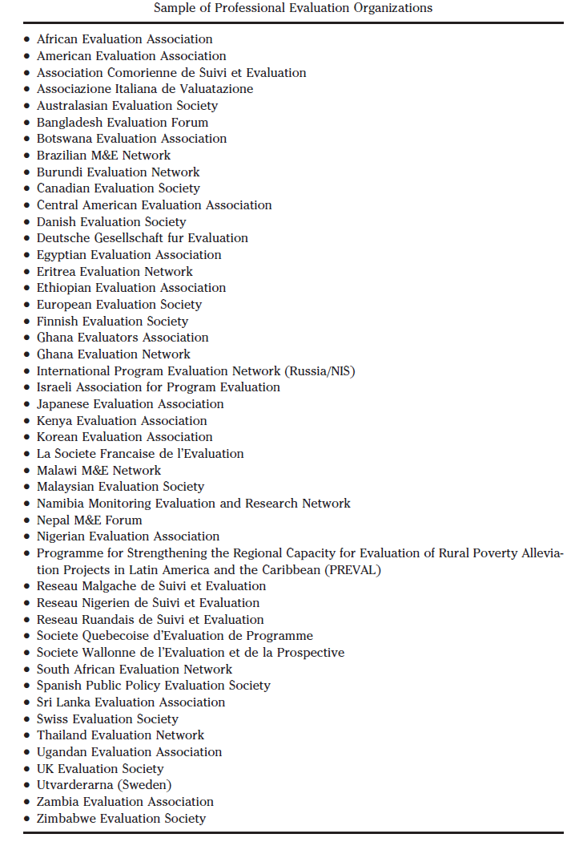

Slide 38
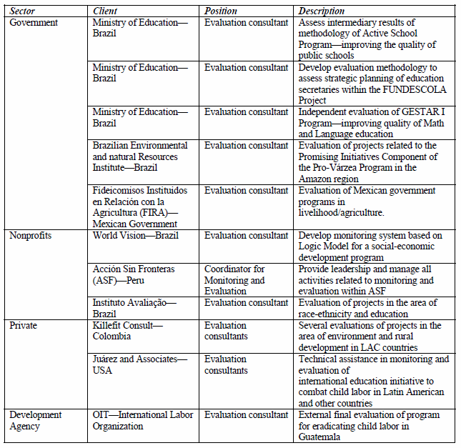

Slide 39

Reading on Evaluation

Slide 40


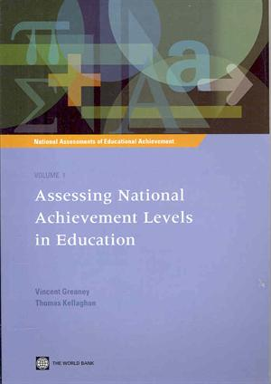

Books on evaluation

Slide 41
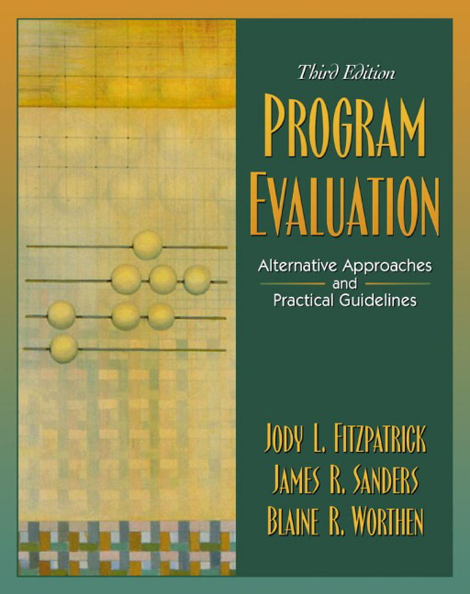

Books on Evaluation

Slide 42

Books on Evaluation

Slide 43

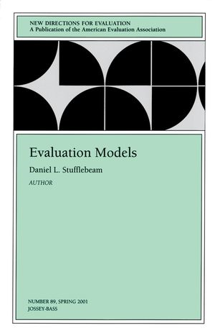
Books on Evaluation

Slide 44
What is Monitoring and Evaluation?
Monitoring (Now sometimes called performance measurement) and evaluation may be considered as separate activities.
However, the term “Evaluation” may be used to cover both activities.
The process of “Monitoring and evaluation” should therefore be considered as complementary parts of an integrated system ( M & E Framework).

Slide 45
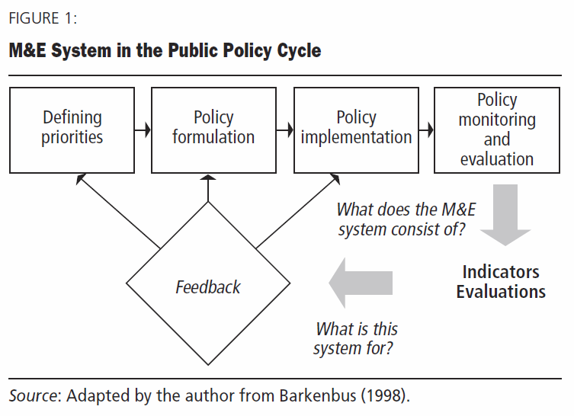

Slide 46
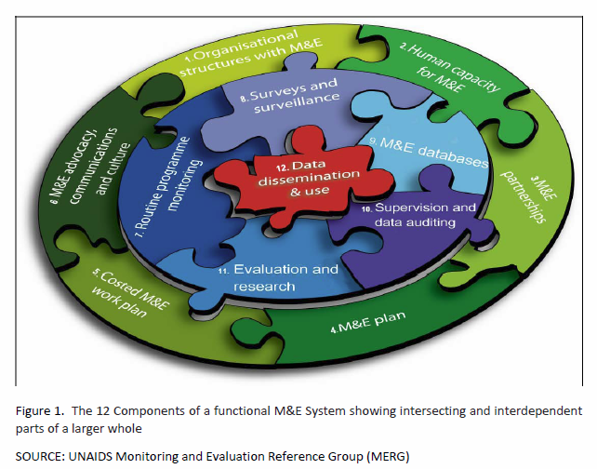

Slide 47
Who does it?
Evaluation activities may be conducted by either internal (state or private) or external agencies.
Data collected in the process may be used to assess and improve the performance of an ongoing programme/projects, as well as assess the impact and the performance of completed projects.

Slide 48
Who teaches it?
In Trinidad and Tobago-University of the West Indies -Faculty of Social Sciences, School of Education (Educational Evaluation), Project Management Courses (Project Evaluation)
Internationally-Evaluation courses are often found in Assessment, Psychology or Research Specializations – Usually multiple courses are required for competence.

Slide 49
Working Definition of Monitoring
Monitoring is an internal management activity in which regular feedback is provided on the progress of the programme implementation and the problems faced.
The purpose of monitoring is to determine whether programmes have been implemented as planned—in other words whether resources are being mobilized as planned and services delivered on schedule (Valdez & Bamberger, 1994).

Slide 50
Working Definition of Evaluation
An internal or external management activity [designed] to assess the appropriateness of a programme’s design and implementation methods in achieving both specified objectives and more general development objectives; and to assess a programme’s results, both intended and unintended and to assess the factors affecting the level and distribution of benefits produced (Valdez & Bamberger, p. 13)

Slide 51
Working Definition of Evaluation
A process of analysis and control designed to determine the relevance, effectiveness, significance, and impact of specified activities and the degree of efficiency with which they are carried out (Chinapah & Miron, 1990)
A systematic activity undertaken to assist an audience to judge and improve the worth of a programme or activity (Windham & Chapman, 1990).

Slide 52
Different from Research?
Some authors distinguish between evaluation and research. The argument is that (1) evaluation goes beyond causal designs and (2) generalization is not always an important goal in an evaluation study and can compromise the relevance of the evaluation to the particular setting (Windham & Chapman, 1990).

Slide 53
Different from Research?
On the other hand, Psacharopolous (1995) has shown that some studies originally classified as “research” were, in fact, well designed evaluations because they included both baseline data and control groups and attempt to make a judgement about the efficiency of a programme or the extent of the change.

Slide 54

Significance of Evaluation
http://portal.unesco.org/education/en/ev.php-URL_ID=23310&URL_DO=DO_TOPIC&URL_SECTION=201.html

Slide 55
Significance (Continued)
Monitoring and evaluation will become key strategies to ascertain the changes and impact of the Decade. An initiative as long and as complex as a Decade must benefit from adequate processes of monitoring and evaluation from the start.
Without that, it will be impossible to know if the Decade is making a difference and what that difference is. A key aspect of monitoring and evaluation will be the identification of suitable and relevant indicators at every level – local, national, regional and international – and for each initiative and programme.

Slide 56
Significance (Continued)
Qualitative and quantitative evaluation methods will be necessary to track the Decade – aspects such as the adoption of values and changes in behaviour cannot be adequately captured by numbers alone.
As far as quantitative approaches are concerned, a wide range of data can be collected. Each initiative at every level will need to its own outcomes and indicators.

Slide 57
Significance (Continued)
In terms of qualitative analysis, ethnographic approaches will enable a close look to be taken at specific communities in terms of changed behaviours, awareness of the values of sustainable development, and adoption of new practices.
Longitudinal studies as well as community-wide ethnographic studies and analyses will provide data and will show the multiple connections in people’s lives between the changes, values, practices, behaviours and relationships which sustainable development implies.
It will be important to identify places for longitudinal studies at the start of the Decade, in both industrialised and developing countries, and in relation to different kinds of ESD initiatives – in formal schooling, public campaigns, non-formal approaches.

Slide 58
Evidence, Policy improvement & Evidence-based
An emerging aspect of policy reform is the increased focus on developing robust monitoring and evaluation systems.
In theory such systems facilitate evidence policy-making and reduce the frequent cases of policy failure.

Slide 59
Evaluation in Trinidad & Tobago
There is growing activity in the area, primarily fostered by the monitoring and evaluation unit(s) across the Public Service.
Several “evaluations” have been attempted by internal and external consultants, although quality and rigour are sometimes limited given the resource constrained environment, chosen methodology, data and time frames demanded.
Sadly, there is no local association and many evaluation professionals have primarily project management specializations.

Slide 60
Evaluation in Trinidad & Tobago
The greatest difficulty seems to be in the area of building evaluation capacity. Evaluation capacity is multi-faceted and norm-based, located at many different levels :
  Individual level consisting of necessary skills and competencies;
  Organizational level of management arrangements and structures;
  Inter-organizational level that bridges public and private bodies through networks, procedures and partnerships; and
  Societal level that embeds evaluative thinking in civil society including professional organizations - as well as in the public sector.

Slide 61
M & E Initiatives in the Public Service-
Address by Patrick Manning at the Prime Minister’s Innovating for Excellence Award Scheme Trinidad Hilton 7th. December 2006
  We are therefore developing a Policy on Monitoring and Evaluation for the entire Public Service of Trinidad and Tobago. We are also already building capacity in this area by training employees in M and E with emphasis on results-based management and stakeholder participation. Consequently there is the spread throughout the service of a basic knowledge of development evaluation concepts, processes, and methods; and an increased level of evaluation knowledge and skills. The evaluation culture is indeed being developed in the public service. . . . . The entire effort in Monitoring and Evaluation will be of great relevance to the further development of excellence in innovation in the nation’s Public Service.

Slide 62
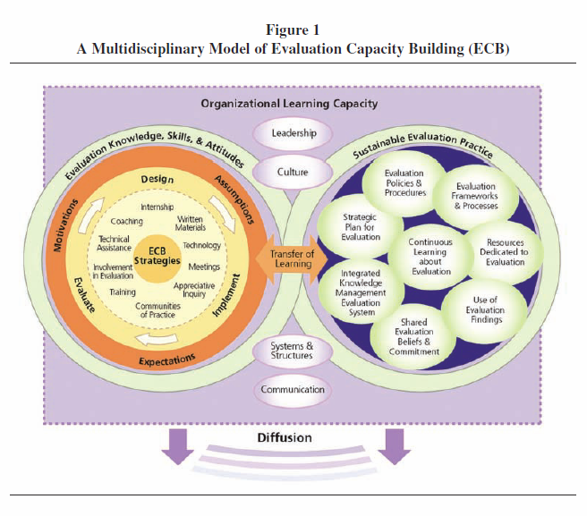

Slide 63
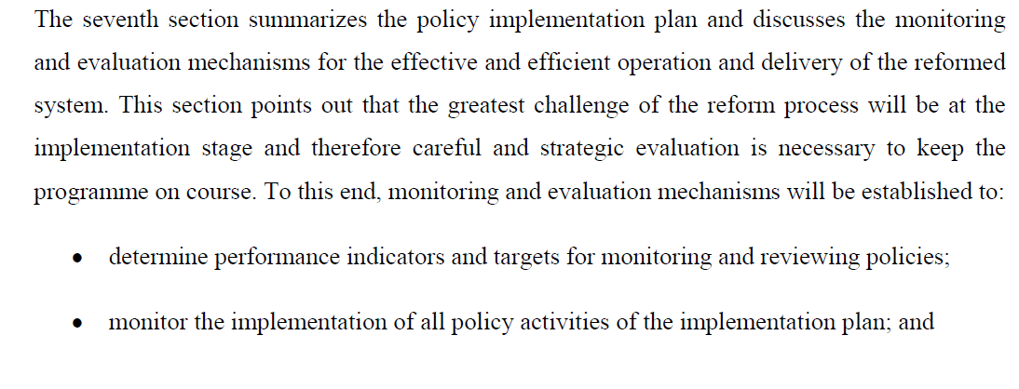
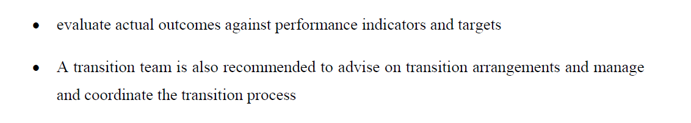
Local government reform-White Paper

Slide 64
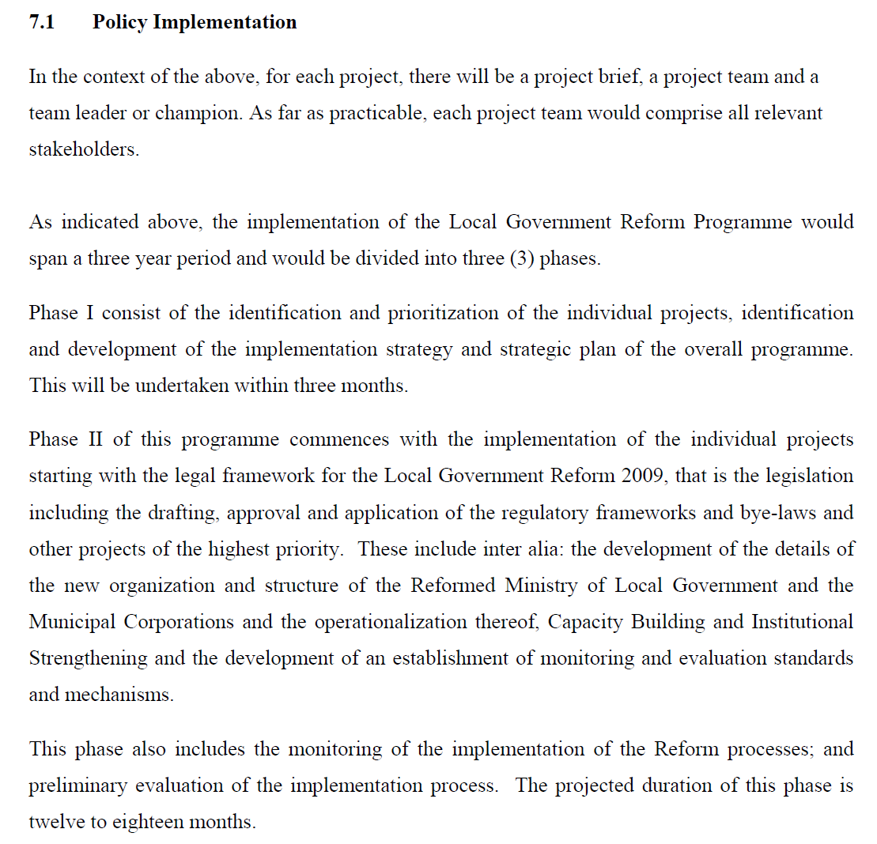

Slide 65
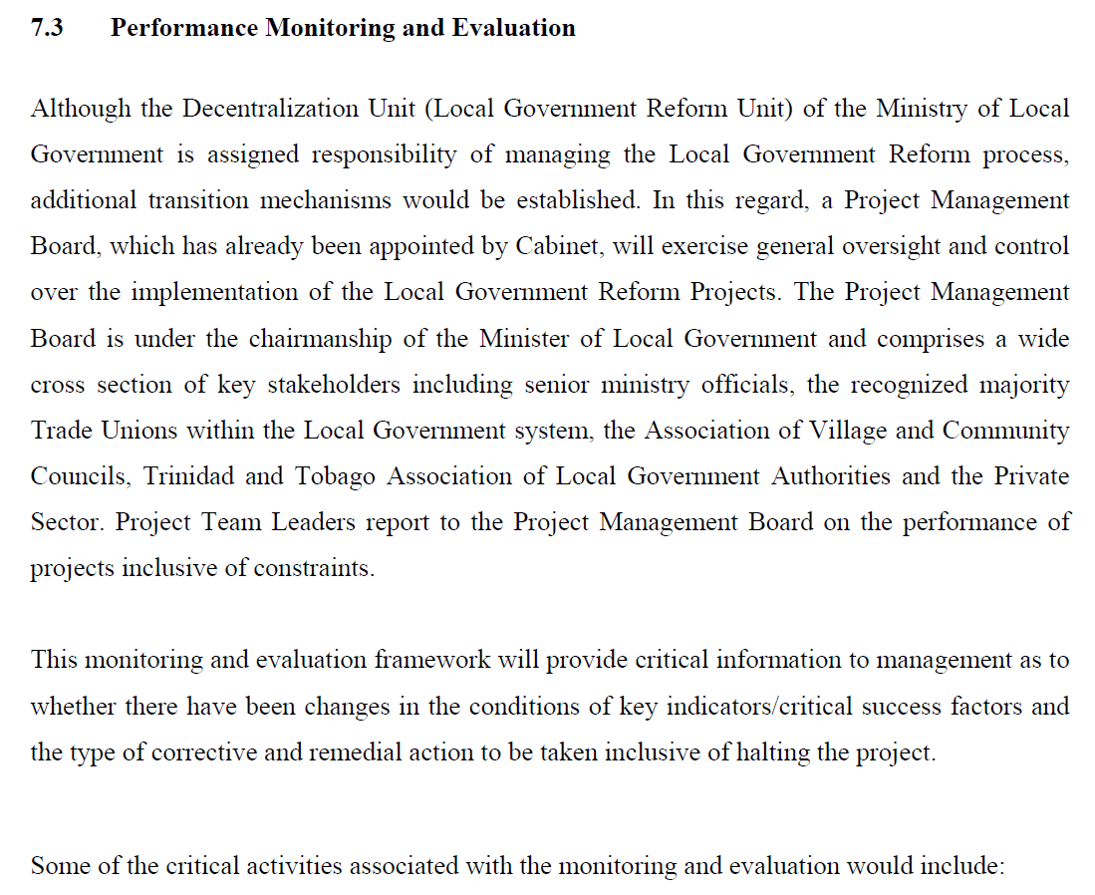
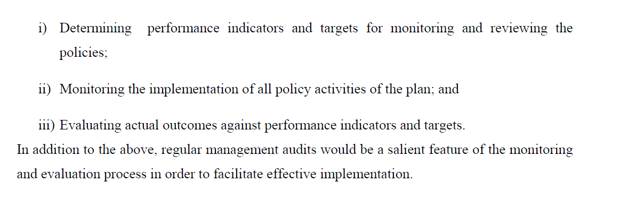

Slide 66
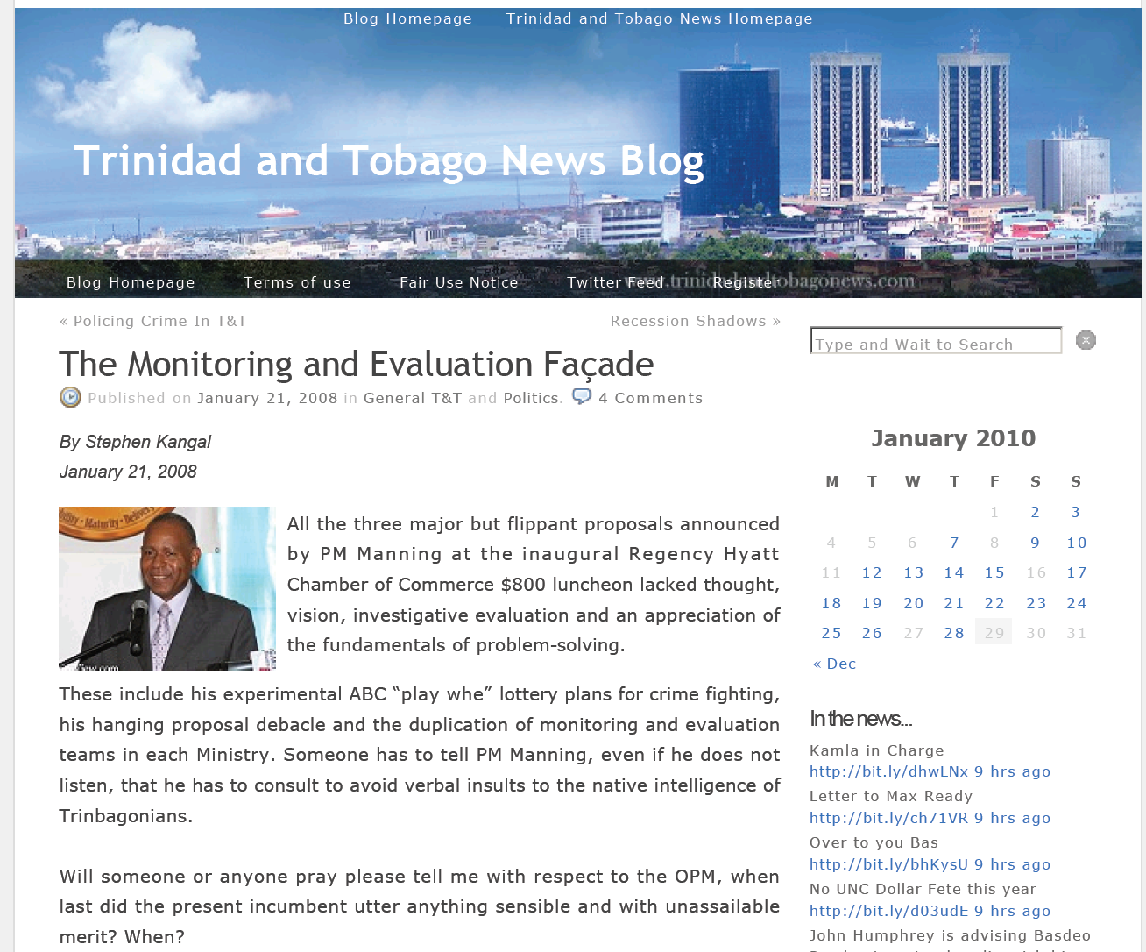
Evaluation in Trinidad & Tobago

Slide 67
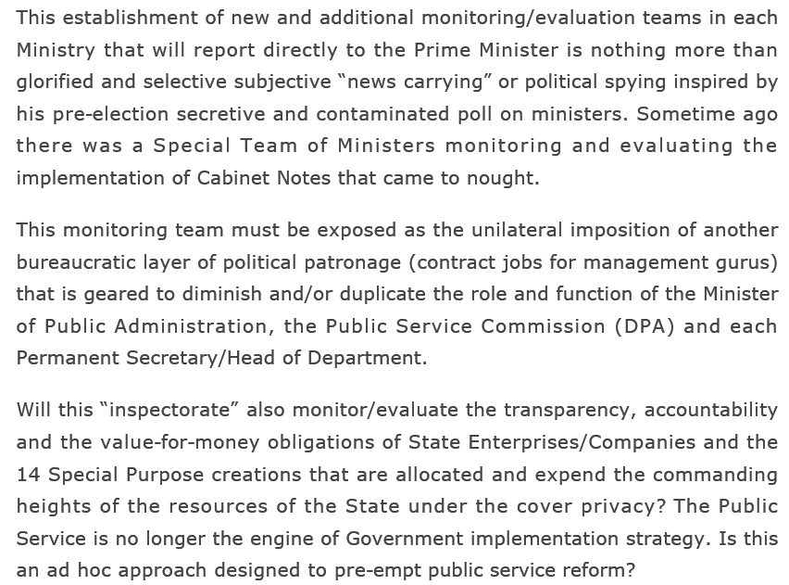

Slide 68
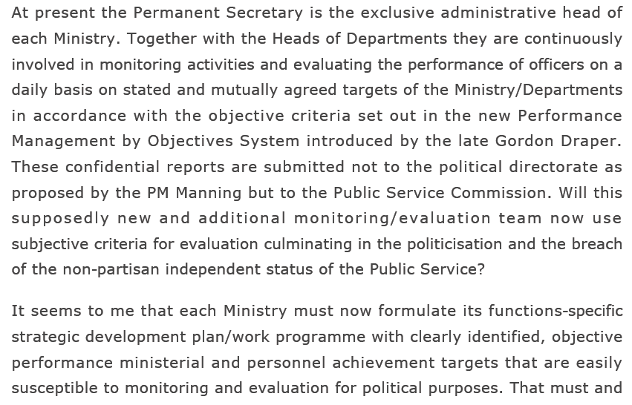

Slide 69
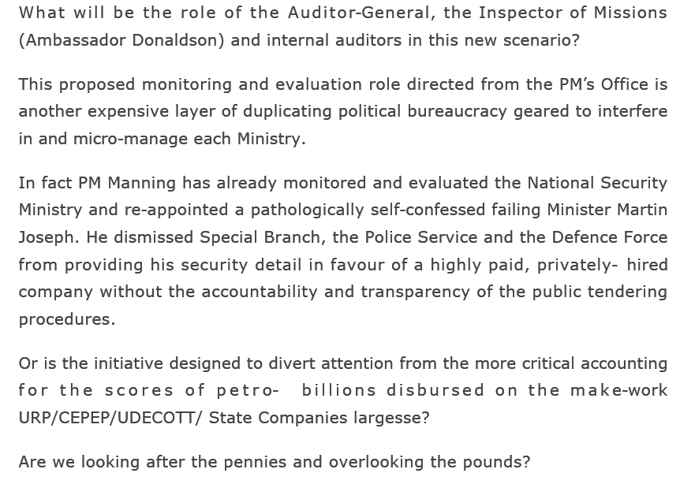

Slide 70
The what of educational evaluation?
What is the nature of educational projects and programmes which must be evaluated?
  Educational projects often cover a wide range of areas, from teaching, learning, assessment and the curriculum to practices and policies that facilitate them.
  Recently funded education programmes may include physical construction, textbook production, and distribution, policy change, and institutional strengthening (Psacharopolous, 1995).

Slide 71
The what of evaluation
Easton (1997) makes use of systems theory to define the structure of an educational programme.
Based partly on Stufflebeam’s CIPP Model, the assemblage of elements in the framework include:
  CONTEXT — The Environment
  INPUTS — Resources, including time.
  PROCESS— Intervention methods or actual programmes undertaken with the resources producing durable change
  OUTPUTS-- Immediate results produced by the activity
  OUTCOMES- Longer term impacts on participants & the environment

Slide 72
The what?

Slide 73
Activity on the what
Identify some programmes at school and at system level that can be evaluated?
Identify aspects of systems performance that should also be evaluated?

Slide 74
The Practice:
Conducting an Evaluation

Slide 75
The Practice:
Conducting an Evaluation

Slide 76
The Practice (Quantitative):
Using Criteria & Standards
The evaluation question provides direction and foundation for the evaluation
Criteria are used to delineate characteristics of successful programmes.
Each criterion may have multiple indicators.
Standards (targets) are used to designate the level of performance expected on each criteria in determining success

Slide 77
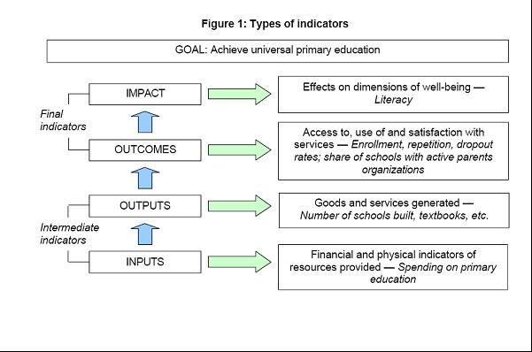

Slide 78
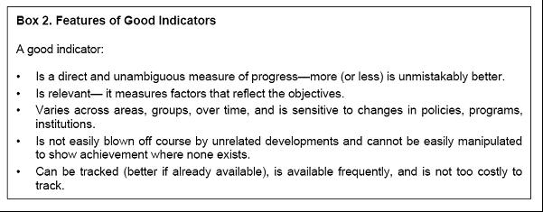

Slide 79
Evaluation Types?
A process evaluation is designed to determine whether a programme has been implemented correctly and according to its guidelines.
Thus operational and implementation problems are identified (Implementation evaluation may be viewed as a separate activity). Relevant questions are:
  Is the intended target group being reached? Are there problems with material and human resources? Is the staff motivated to complete the activity? (This is essentially equivalent to monitoring and also called formative evaluation. (Also called Input evaluation in Stufflebeam’s 1971 framework)

Slide 80
Evaluation Types
An outcome/ impact evaluation assesses the impact of a programme or intervention on its intended target group and objectives.
  To what extent is the programme producing the desired change? What are the operational objectives? (Also called summative or impact evaluation)
A holistic evaluation includes both process and impact evaluations. Has the approved criteria and objectives been changed?

Slide 81
Evaluation Types
A comprehensive evaluation will include monitoring activities, cost-benefit evaluation, and outcome and impact evaluation.
  Is the programme implemented as planned? What problems have arisen? How is the programme operating? What is the cost-benefits of the current use of resources, especially as regards to alternatives programmes? How did the programme affect the beneficiaries? Were improvements a direct result of the project?

Slide 82
Evaluation Types
Evaluability Assessment explores the objectives, expectations, and information needs of program managers and policy makers; explores program reality; assesses the likelihood that program activities will achieve measurable progress toward program objectives; and assesses the extent to which evaluation information is likely to be used by program management.
  Wholey, J. S. (1979). Evaluation: Promise and performance. Washington, DC: The Urban Institute: Author.

Slide 83
Evaluation Types
Ex Ante Evaluation
  to identify the current conditions, issues, opportunities, and constraints in the environment, serving as a background for more specific project design activities to follow.
  ex ante evaluation makes it possible to optimally design a program that achieves some desired impacts at a minimum cost or maximizes impacts for a given cost
    (Also called Needs assessment/needs analysis).

Slide 87
Homework: Is it an evaluation?
Find a journal article or internet document that presents an evaluation report for any system indicator such as literacy or numeracy or educational programme at the school or system level (Such as a violence reduction programme/HIV/AIDS awareness programme).
Summarize that article (one page)
Say why you think it is an evaluation (one page)

